Slide 1
D2L- e-learning Course Build
Hampton Roads Virtual Learning Center

Slide 2
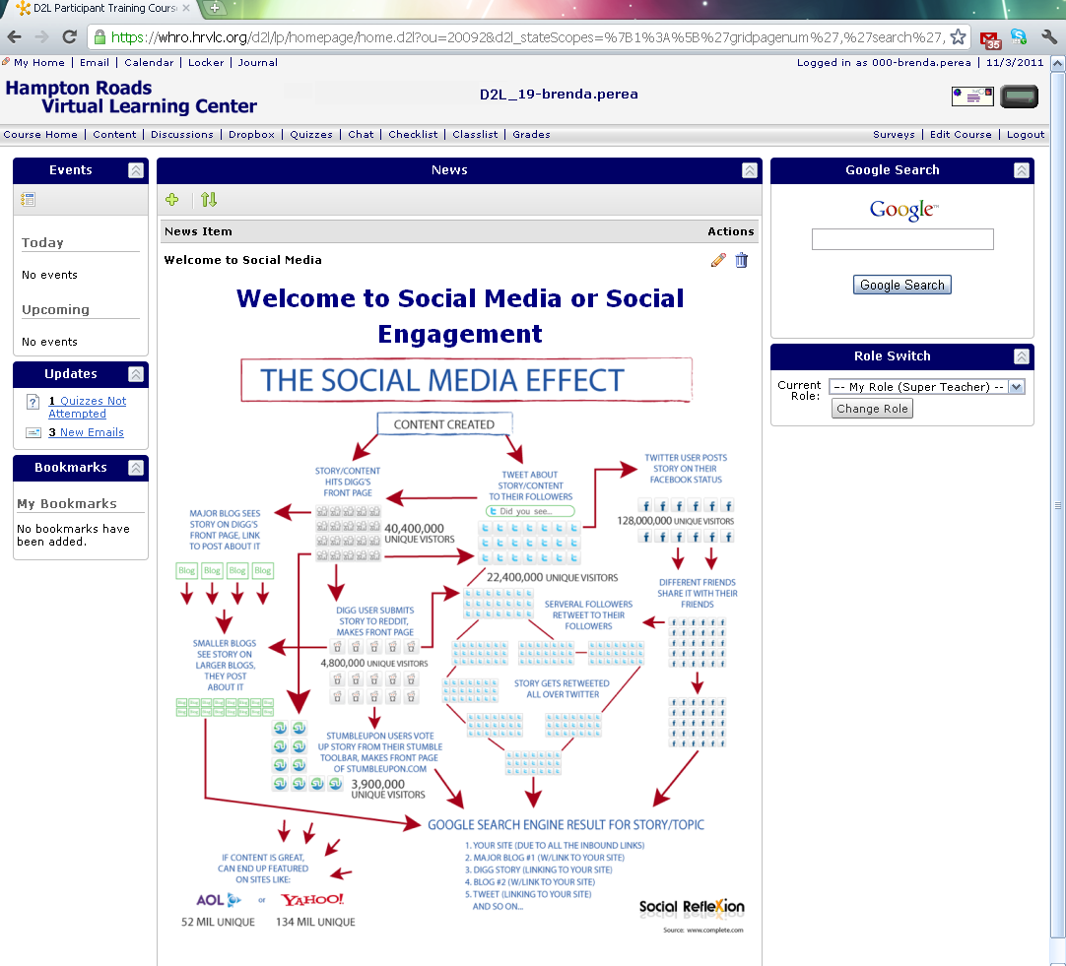
Scope of the Project
Introduce Social Media
Demonstrate the use of Social Media as a individual.
Analyze the use of Social Media as a corporation/business identity.
Justify the use of Social Media as a marketing tool

Slide 3
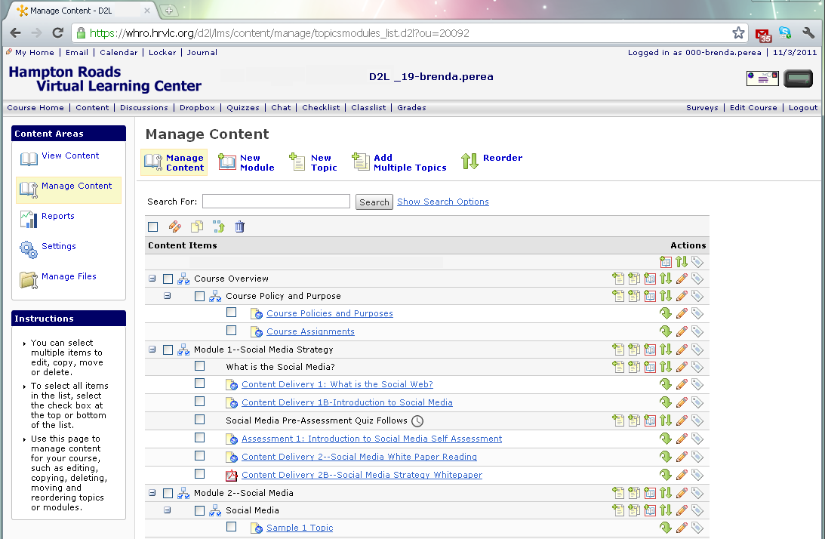
The Course developed into 5 Modules covering Content Delivery, Discussion Threads, group and individual social media exploration and end of module assessments.

Slide 4
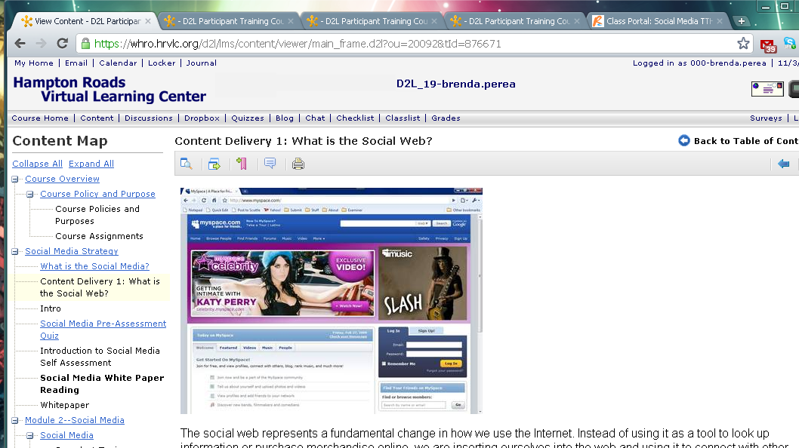
Content Pages with Embedded Multimedia

Slide 5
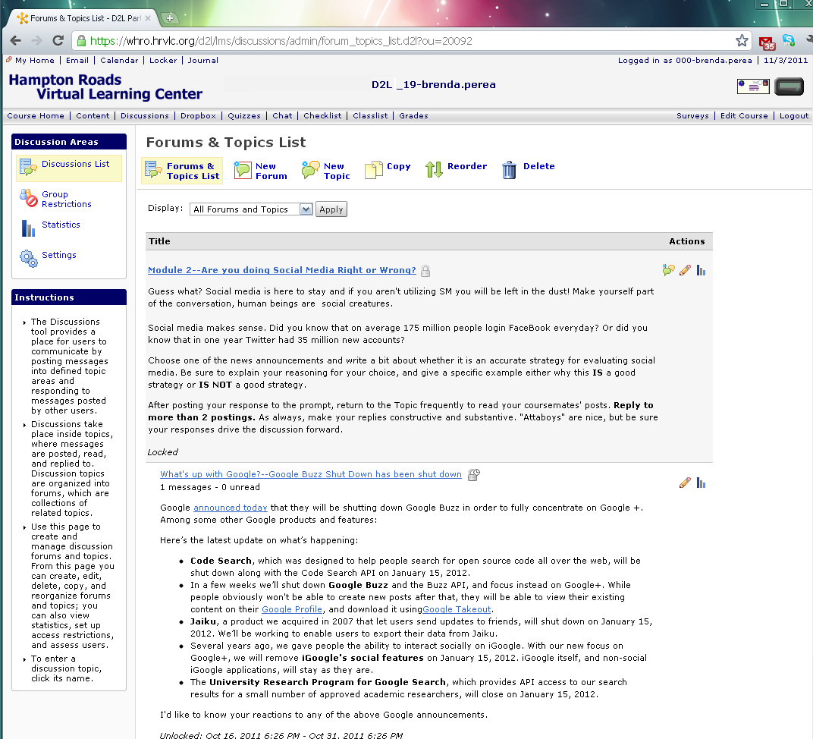
Discussion Threads Developed with Specific Guidelines

Slide 6
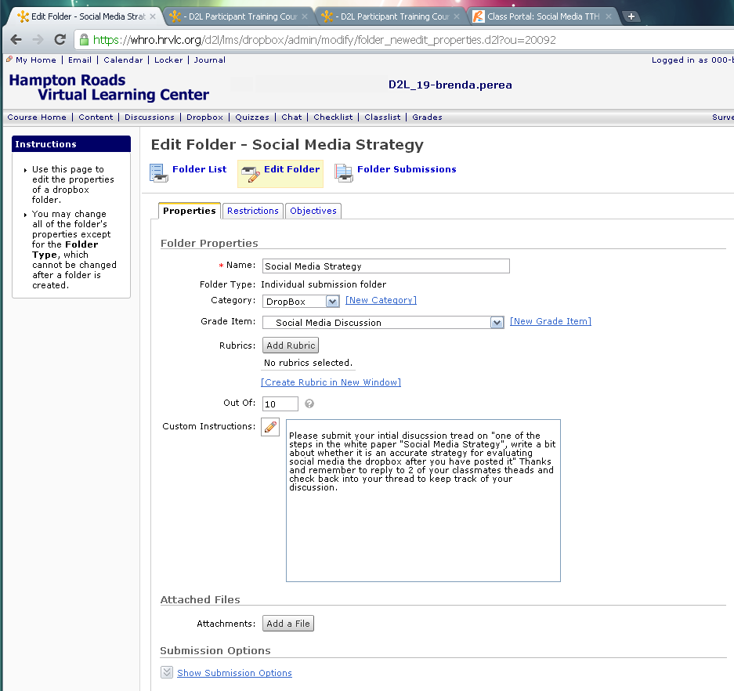
Projects Developed

Slide 7
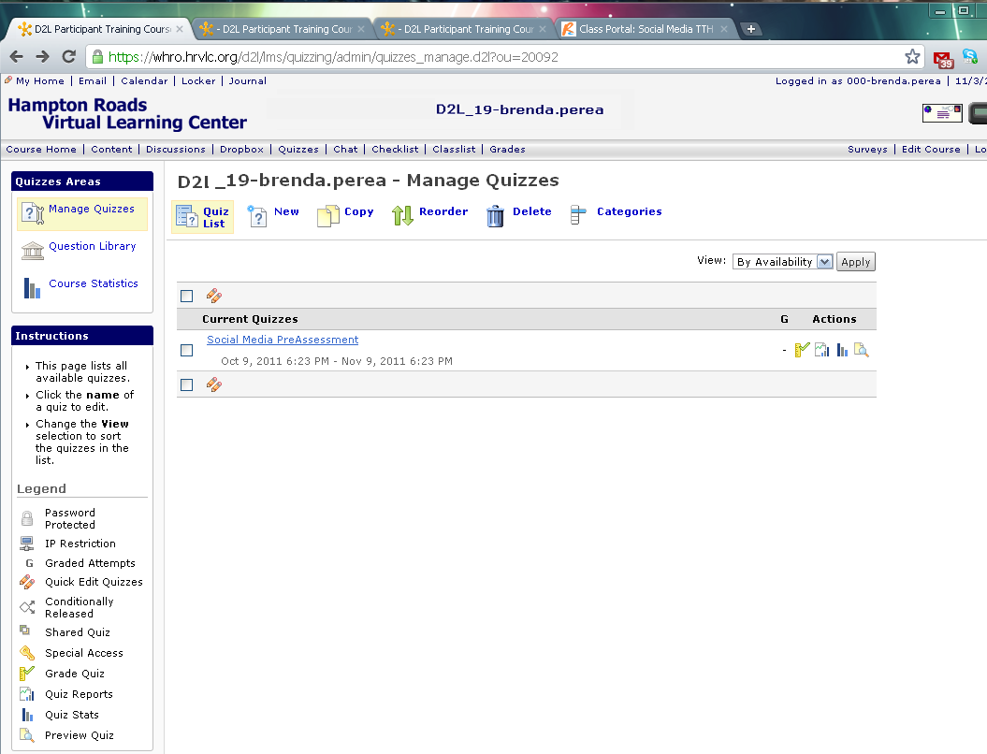
Pre and Post Module Quizzes Created

Slide 8
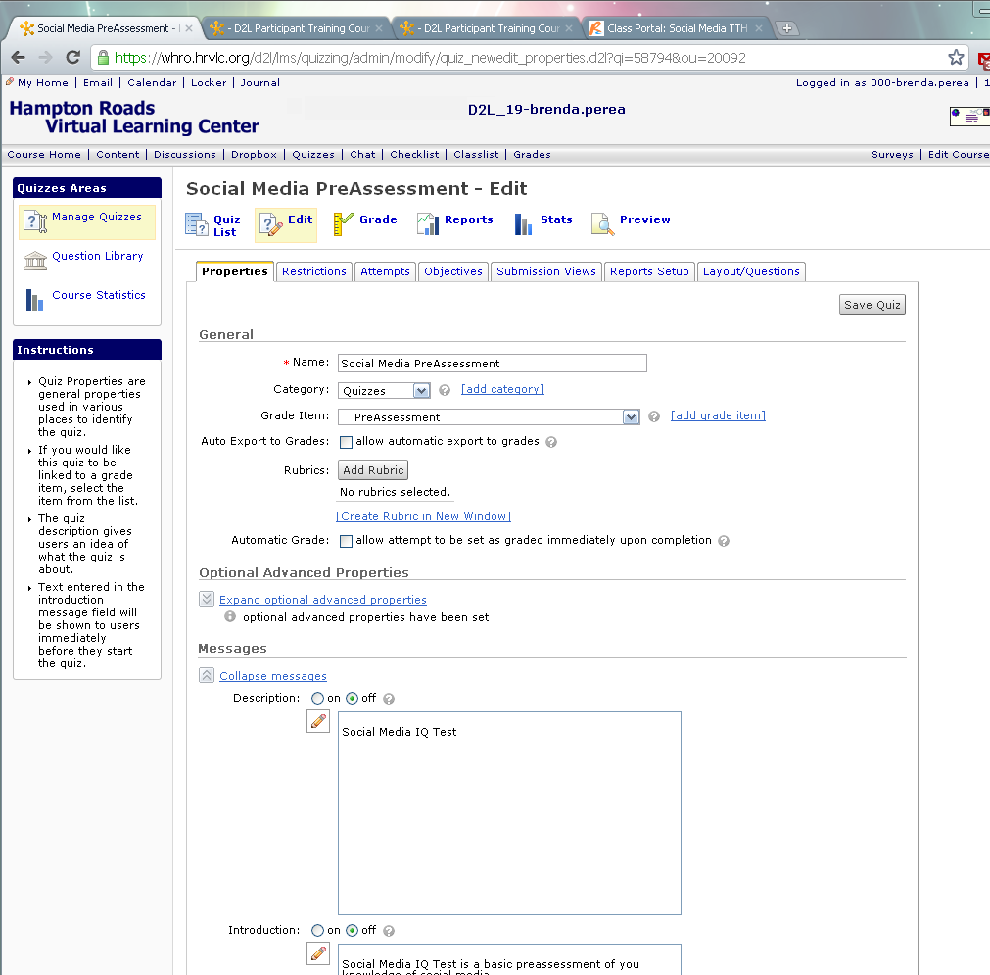
Assessments Created Developed

Slide 9
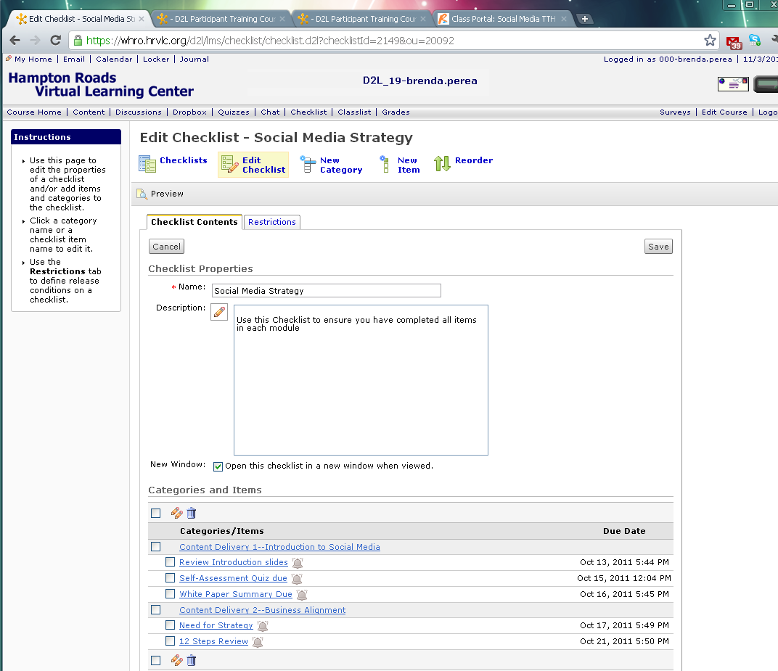
Sequencing of Learning enforced with Course Checklist

