Slide 1
Instructional Design methodology of
Conflict Resolution sample course
This is a sample of a moderated or facilitated self-directed eLearning course with cohort group interactions . The cohort group interactions are in cloud based discussion groups (Google Groups).
The course was developed to benefit all levels of employees in the eLearning software Articulate. The course has also been designed so its component modules can easily be uploaded into a LMS/LCMS or a CMS platform.
It was designed as a 13 module course, but you will only sample the introduction and Module 1 contained in slides 1-18, slide 19-49 are placeholders for the development of the full course.
The design elements include:
an introduction in Flash—audio and video combined in Camtasia
a URL link to an web-based quiz
a URL link to a cloud based discussion board
2 Engage User Interactions slides
1 Module Learning Assessment
The course will begin with upon your mouse click.
Notes:
This is a sample of a moderated/facilitated self-directed eLearning course with cohort group interactions . The cohort group interactions are in cloud based discussion groups (Google Groups).
The course was developed to benefit all levels of employees in the eLearning software Articulate. The course has also been designed so its component modules can easily be uploaded into a LMS/LCMS or a CMS platform.
It was designed as a 13 module course, but you will only sample the introduction and the first module.
The design elements include:
an introduction in Flash—audio and video combined then published in Camtasia
2 Engage User Interactions slides
1 Survey Quiz-created in Quizmaker
1 Assessment–created in Articulate

Slide 2
Conflict Resolution 101
Notes:
Did you know that a little conflict in your office today can shut down your entire operation tomorrow? That is no exaggeration! Workplace conflict costs. It starts by reducing productivity and employee health.
In this self-paced course you will learn how you can avoid conflict from developing, and methods you can use to resolve conflicts that are occurring and affecting your workplace.
Conflict comes about from differences - in communication, needs, values and motivations. Sometimes through these differences we complement each other, but sometimes we will conflict. Conflict is not a problem in itself - it is what we do with it that counts.
It is important that we do something because whether we like it or not, conflicts demand our energy. In fact, an unresolved conflict can call on tremendous amounts of our attention. We all know how exhausting an unresolved conflict can be.
Animosity.
Dissent.
Anger.
Frustration.
Rage.
Disagreements.
Differences of opinion.
Yelling.
Personal attack.
Vindictiveness.
Conflict.
They make great TV but a terrible work environment.

Slide 3

Purpose and Objectives
This course provides:
Learners with background knowledge and theory to identify their own communication style
The confidence to identify and employ attitudinal changes
The ability to apply the necessary skills to diverse workplace, community and personal conflicts
Conflict is the Stuff of Life.
How can you resolve conflicts more successfully?
This course will help teach you the Conflict Resolution skills of effective communication to help you build more unified organizations and more rewarding relationships.
Conflict Resolution Skills Create Better Work Climates and More Fulfilling Relationships
For an organization, skilful conflict-handling is an important tool. Conflict can be seen as an opportunity for learning more about the company - its bottle-necks and inefficiencies, as well as its areas of expertise. The benefits of conflict often go unrecognized when staff and management react with "fight" or "flight". To benefit from conflict we need to “Flow", this way requires Conflict Resolution skills.
Notes:
Conflict is the Stuff of Life.
Have you ever had a conflict and wished you could have handled it better?
How can you resolve conflicts more successfully?
This course will help teach you the Conflict Resolution skills of effective communication to help you build more unified organizations and more rewarding relationships.
Conflict resolution skills enable us to bypass personal differences and to open up to possibilities. The skills of conflict resolution draw us closer to other people, as we jointly search for fair solutions and balanced needs. It involves a powerful shift from adversaries to co-operative partners. In this shift each person benefits.
Conflict Resolution Skills Create Better Work Climates and More Fulfilling Relationships
For an organization, skilful conflict-handling is an important tool. Conflict can be seen as an opportunity for learning more about the company - its bottle-necks and inefficiencies, as well as its areas of expertise. The benefits of conflict often go unrecognized when staff and management react with "fight" or "flight". To benefit from conflict we need to “Flow", this way requires Conflict Resolution skills.
As you work through these online course modules, you will learn basic skills of Conflict Resolution. You will find these skills transfer very easily. You can use the same skills in your personal life as your professional life. The skills taught in this course are the same whether you utilizing them to resolve conflict in a community, a national organization or your own workplace.
Enjoy the journey.

Slide 4

Course Overview
This course will provide a set of principles and conversational protocols that provides a road map for difficult conversations people often avoid.
Executives, managers, team leads and co-workers are reluctant to engage in these difficult conversations because they do not have a map to navigate through difficult conversations. They do not know how to get into, through, and out of the dialogues.
The effectiveness of any collaboration and any organization reflects the quality of the relationships and the quality of agreements among the participants. The goal of the interventions is a “culture of agreement and resolution” where everyone has the same vision, the same path to get there, and the same tools to keep them on track.
Working through this course, you will gain the necessary skills for improving communication and resolving conflict.
You will gain skills in the following techniques:
Win/Win | Creative Response
Empathy | Appropriate Assertiveness
Co-operative Power | Managing Emotions
Willingness to Resolve | Mapping the Conflict
Designing Options | Negotiation
Introduction to Mediation | Broadening Perspectives
Notes:
This course will provide a set of principles and conversational protocols that provides a road map for difficult conversations people often avoid.
Executives, managers, team leads and co-workers are reluctant to engage in these difficult conversations because they do not have a map to navigate through difficult conversations. They do not know how to get into, through, and out of the dialogues.
The effectiveness of any collaboration and any organization reflects the quality of the relationships and the quality of agreements among the participants. The goal of the interventions is a “culture of agreement and resolution” where everyone has the same vision, the same path to get there, and the same tools to keep them on track.
Working through this course, you will gain the necessary skills for improving communication and resolving conflict.

Slide 5
Learning Outcomes
By successfully completing this course, students will be able to:
Identify their own communication skills and describe the types of conflict that occur in the workplace.
Define why people conflict in the first place.
Describe the consequences of conflict in the workplace.
Summarize procedures to resolve workplace conflict.
Summarize steps to take when conflicts are not resolved.
Summarize ways to stop conflict from arising in the first place.
Describe the most common techniques to resolve personal conflict.
Describe ways to mediate conflict between parties.
Describe what steps to take when both parties refuse to resolve their conflicts
Demonstrate mastery of lesson content at levels of 70% or higher.
Move to the next section upon mouse click
Notes:
The course is divided into eleven modules, each module offers approximately three hours of intensive training in that skill and additional time is spent in online discussion boards discussing specific conflict cases and developing ways to resolve the conflict.

Slide 6

Module 1—Communication and Conflict
Learning Objectives:
Identify your communication effectiveness
Identify, describe, and define the types of conflict that occur
Describe consequences of conflict in the workplace.
Identify how to use communication effectively in difficult and emotive situations to de-escalate conflict
Identify a Conflict Resolution Process
Notes:
Communication styles and the Identification of Types of Conflict
The information in this module will help identify types of conflict- such as what it is and why it occurs so often in the workplace.
You will learn to identify the types of conflict that occur in the workplace, and familiarize yourself with two theories of Conflict Theory.
Conflict in the workplace can be incredibly destructive to good teamwork.
Managed in the wrong way, real and legitimate differences between people can quickly spiral out of control, resulting in situations where co-operation breaks down and the team's mission is threatened. This is particularly the case where the wrong approaches to conflict resolution are used.
To calm these situations down, it helps to take a positive approach to conflict resolution, where discussion is courteous and non-confrontational, and the focus is on issues rather than on individuals. If this is done, then, as long as people listen carefully and explore facts, issues and possible solutions properly, conflict can often be resolved effectively.

Slide 7
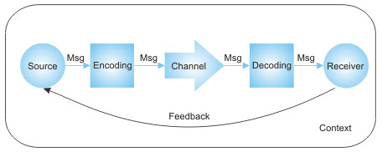

Learning Activity 1--Identify your Communication Style
Communication skills are some of the most important skills you need to succeed in the workplace. We talk to people face to face, and we listen when people talk to us. We write emails and reports, and we read the documents that are sent to us.
Communication, therefore, is a process that involves at least two people – a sender and a receiver. For it to be successful, the receiver must understand the message in the way that the sender intended. This sounds quite simple. But have you ever been in a situation where this hasn't happened?
Misunderstanding and confusion often occur, and they can cause enormous problems, yes even conflict. If you want to be an effective communicator, you need to be effective at all points in the communication process – whether as a sender or receiver of communication. Whenever you communicate with someone else, you and the other person follow the steps of the communication process.
Are you communicating effectively?
This graphic represents the communication process under “normal” circumstances. Here, the person who is the source of the communication, transmits a message through a channel and the receiver accepts the message and in one way or another provides feedback to the source. In conflict, the communication process feedback is either corrupted or does not exist.
If you want to be an effective communicator, you need to be effective at all points in the communication process – whether as a sender or receiver.
Shortly, a new browser window will open where you will read a short article on communication, and take the short survey “How good are your Communication Skills?”—After you have taken the survey, remember to either print out the page using your internet browser print button or copy down your score…you will use this information later in the module.
Notes:
Communication skills are some of the most important skills you need to succeed in the workplace.
We talk to people face to face, and we listen when people talk to us. We write emails and reports, and we read the documents that are sent to us. Communication, therefore, is a process that involves at least two people – a sender and a receiver. For it to be successful, the receiver must understand the message in the way that the sender intended.
This sounds quite simple. But have you ever been in a situation where this hasn't happened? Misunderstanding and confusion often occur, and they can cause enormous problems, yes even conflict.
If you want to be an effective communicator, you need to be effective at all points in the communication process – whether as a sender or receiver of communication. Whenever you communicate with someone else, you and the other person follow the steps of the communication process. This graphic represents the communication process under “normal” circumstances.In conflict, the communication process feedback is either corrupted or does not exist.
Are you communicating effectively? Shortly, a new browser window will open where you will read a short article on communication, and take the short survey to find out “How good are your Communication Skills?—After you have taken the survey, remember to either print out the page using your internet browser print button or copy down your score…you will use this information later in the module.

Slide 8
Learning Activity 1--conclusion
This next activity is going to help you integrate the information you learned in the Communication Quiz and your awareness of effective communication to help resolve conflict.
You will be discussing a communication scenario on a discussion board.
A new browser window will open allowing you to view the short video– Ann and Pete--Communicate.
Utilizing the knowledge about your own communication style and the information you have gained about effective communication, (a new browser window will open, asking you to sign in using your Google Groups log in), post a comment on Discussion Thread 3 on how you believe the lines of communication have broken down between Ann and Pete. Additionally, propose one or two new strategies to help increase effective communication. (you might want to format your ideas in a text or MSWord document.)
Post a short, no shorter than 140 characters, reactionary response to at least 2 of your other cohorts’ posts. Remember to be an excellent communicator as well as a non-judgmental communicator.
Notes:
This next activity is going to help you integrate the information you learned in the Communication Quiz and your awareness of effective communication to help resolve conflict.
You will be discussing a communication scenario on a discussion board. Follow the directions below to complete the assignment.
View this video– Ann and Pete--Communication scenario video.
Utilizing the knowledge about your own communication style and the information you have gained about effective communication and using your Google Groups sign in, post a comment on Discussion Thread 3, how the lines of communication have broken down between the two people in the scenario. Additionally, propose one or two new strategies to help increase effective communication. (you might want to format your ideas in a text or MSWord document.)
Post a short, no shorter than 140 characters, reactionary response to at least 2 of your other cohorts’ posts. Remember to be an excellent communicator as well as a non-judgmental communicator.

Slide 9


What is Conflict?
In many cases, conflict in the workplace just seems to be a fact of life. We’ve all seen situations where different people with different goals, needs, values, motivations, and communication styles have come into conflict and we have all seen the often intense personal animosity that can result.
Besides crafting good conflict resolution agreements, an important aim of the intervention is to "normalize" conflict so people will not remain emotionally triggered—they internalize the skills and temperament to get through the "white-water" that is challenging them on the way to the skill and goal of reaching more effective collaboration agreements. The long term goal is the realization that when disagreements occur a fight does not have to follow—you just need a new agreement. When an organization, or a collaborative partnership of any kind, embraces the cyclical process of resolution, there is little drain on productive capacity.
The fact that conflict exists, however, is not necessarily a bad thing: As long as it is resolved effectively, it can lead to personal and professional growth. In many cases, effective conflict resolution can make the difference between positive and negative outcomes.
According to psychologists Art Bell and Brett Hart, there are eight common causes of conflict in the workplace.
Conflicting resources, styles, perceptions, goals, pressures and roles
Different personal values.
Unpredictable policies.
Effective conflict resolution is a process of developing an “attitude of resolution”—enrolling people through the realization of just how large the huge cost of conflict really is and understanding that most conflict is not about bad intention—most conflict is structural, a function of different individual characteristics, needs, and outcomes.
Notes:
In many cases, conflict in the workplace just seems to be a fact of life. We’ve all seen situations where different people with different goals needs, values, motivations, and communication styles have come into conflict and we have all seen the often intense personal animosity that can result.
Besides crafting good conflict resolution agreements, an important aim of the intervention is to "normalize" conflict so people will not remain emotionally triggered—they internalize the skills and temperament to get through the "white-water" that is challenging them on the way to the skill and goal of reaching more effective collaboration agreements. The long term goal is the realization that when disagreements occur a fight does not have to follow—you just need a new agreement. When an organization, or a collaborative partnership of any kind, embraces the cyclical process of resolution, there is little drain on productive capacity.
The fact that conflict exists, however, is not necessarily a bad thing: As long as it is resolved effectively, it can lead to personal and professional growth. In many cases, effective conflict resolution can make the difference between positive and negative outcomes.
Effective conflict resolution is a process of developing an “attitude of resolution”—enrolling people through the realization of just how large the huge cost of conflict really is and understanding that most conflict is not about bad intention—most conflict is structural, a function of different individual characteristics, needs, and outcomes.

Slide 10

What does Communication have to do with Conflict?
Few people have learned the skills needed to continue forward to collaborate effectively when confronted with conflict.
Most people do not have the map to solid communication, or an "agreement for results“—which are the basic building blocks of collaborations and organizational culture.
The ability to engage the dialogue of collaboration and conflict resolution requires some basic traditional communication skills (self-awareness, listening, and emotional intelligence); that make up conversational steps.
Another key premise is no matter how good the communication is on the front end, conflict will arise because of changing and unforeseen circumstances, incompleteness, and personal challenges.
Notes:
When neighbors feud, lovers quarrel or nations war, the predictable remedy prescribed by the voices of reason is communication. The prevailing view is that, faced with conflict, communicating is always the right thing to do: The U.N. Security Council encourages hostile countries to "hold talks," and marriage counselors advise quarreling couples to "express their feelings." So commonplace is the prescription, it's difficult to imagine the Secretary General imploring hostile nations to refrain from dialogue.
Different needs, and the lack of clear explicit agreements, leads to conflict. Few people have learned the skills needed to continue forward to collaborate effectively when confronted with conflict. They do not have the map to solid communication or an "agreement for results“—which are the basic building blocks of collaborations and organizational culture.
The ability to engage the dialogue of collaboration and conflict resolution requires some basic traditional communication skills (self-awareness, listening, and emotional intelligence); that make up conversational steps.
Another key premise is no matter how good the communication is on the front end, conflict will arise because of changing and unforeseen circumstances, incompleteness, and personal challenges.

Slide 11
Benefits of Conflict Resolution
Resolving conflict successfully:
Increases understanding:
  expands people’s awareness of the situation, giving them an insight to achieve their own goals without undermining those of other people.
Increases group cohesion:
  team members can develop stronger mutual respect, and a renewed faith in their ability to work together.
Improves self-knowledge:
  helping individuals understand the things that are most important to them, sharpening their focus, and enhancing their effectiveness
Notes:
The good news is that by resolving conflict successfully, you can solve many of the problems that it has brought to the surface, as well as getting benefits that you might not at first expect:
Increases understanding: Discussions needed to resolve conflict expands people’s awareness of the situation, giving them an insight into how they can achieve their own goals without undermining those of other people.
Increases group cohesion: When conflict is resolved effectively, team members can develop stronger mutual respect, and a renewed faith in their ability to work together.
Improves self-knowledge: Conflict pushes individuals to examine their goals in close details, helping them understand the things that are most important to them, sharpening their focus, and enhancing their effectiveness.
However, if conflict is not handled effectively, the results can be damaging. Conflicting goals can quickly turn into personal dislike. Teamwork breaks down, talent is wasted as people disengage from their work, ending up in a vicious downward spiral of negativity and recrimination.

Slide 12
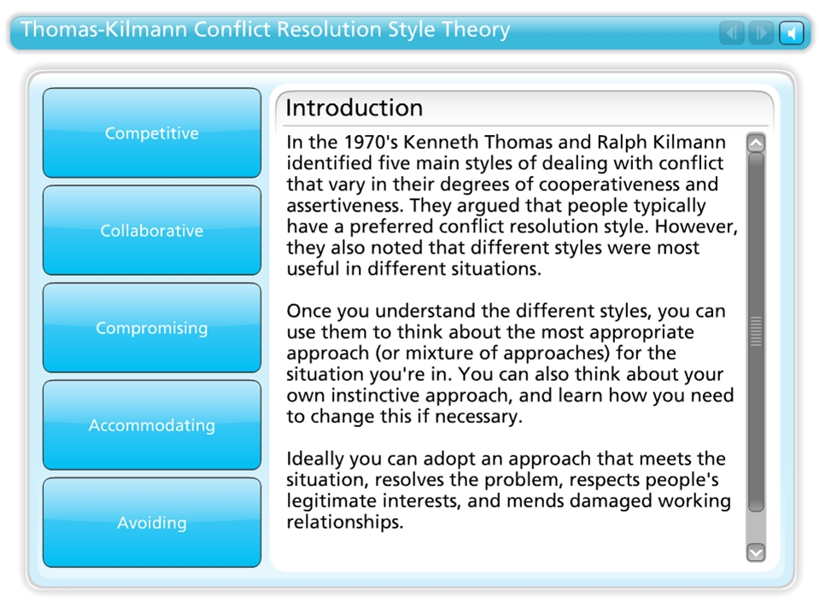



Thomas-Kilmann Conflict Resolution Style Theory

Slide 13
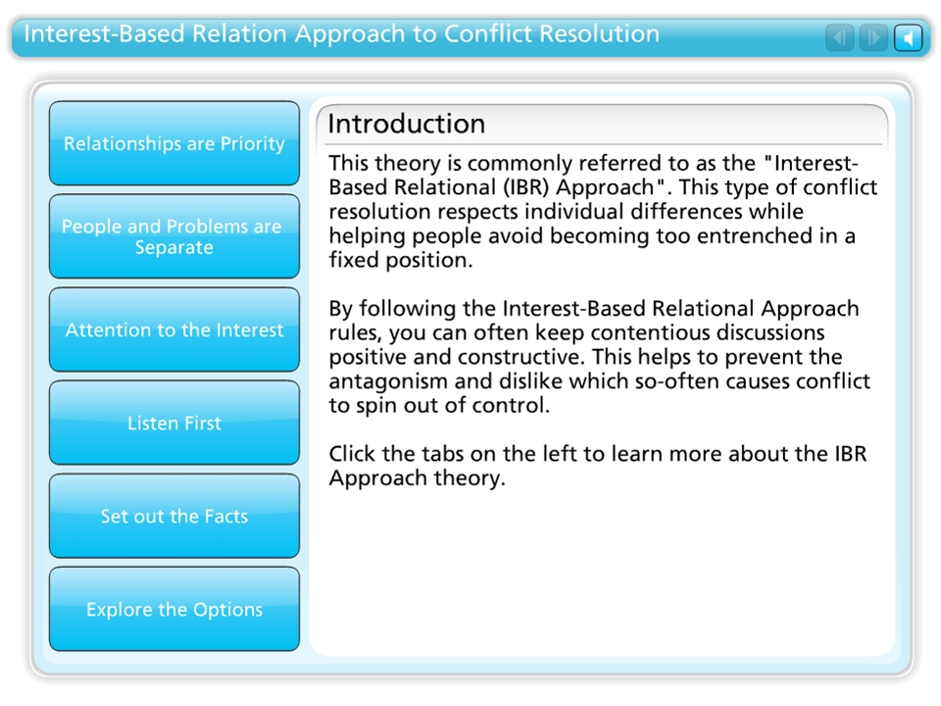
Interest-Based Relation Approach to Conflict Resolution

Slide 14
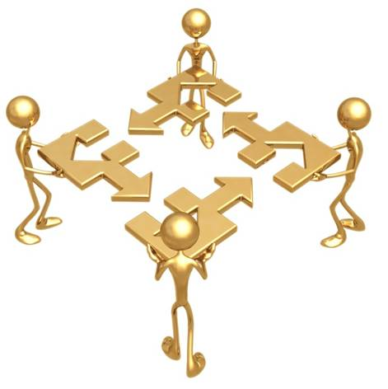
Conflict Resolution Process
Step 1—Set the Scene
Step 2—Gather Information
Step 3—Agree on the Problem
Step 4—Utilize Conflict Resolution skills to develop a solution
Step 5—Negotiate a Solution
Notes:
Conflict resolution is like putting together a puzzle. It helps to use a tool or process as a starting point for dealing with conflict is to identify the overriding conflict style employed by yourself, your team or your organization.
Over time, people's conflict management styles tend to mesh, and a "right" way to solve conflict emerges. It's good to recognize when this style can be used effectively, however make sure that people understand that different styles may suit different situations.
A general process for Conflict resolution includes these steps:
Step One: Set the Scene
If appropriate to the situation, agree a set of rules for the conflict resolution (consider using the Interest Based Relational Approach) Make sure that people understand that the conflict may be a mutual problem, which may be best resolved through discussion and negotiation rather than through raw aggression.
If you are involved in the conflict, emphasize the fact that you are presenting your perception of the problem. Use active listening skills to ensure you hear and understand other's positions and perceptions.
Restate.
Paraphrase.
Summarize.
And make sure that when you talk, you're using an adult, assertive approach rather than a submissive or aggressive style.
Step Two: Gather Information
Here you are trying to get to the underlying interests, needs, and concerns. Ask for the other person's viewpoint and confirm that you respect his or her opinion and need his or her cooperation to solve the problem.
Try to understand his or her motivations and goals, and see how your actions may be affecting these.
Also, try to understand the conflict in objective terms: Is it affecting work performance? damaging the delivery to the client? disrupting team work? hampering decision-making? or so on. Be sure to focus on work issues and leave personalities out of the discussion.
Listen with empathy and see the conflict from the other person's point of view.
Identify issues clearly and concisely.
Use "I" statements.
Remain flexible.
Clarify feelings.
Step Three: Agree the Problem
This sounds like an obvious step, but often different underlying needs, interests and goals can cause people to perceive problems very differently. You'll need to agree the problems that you are trying to solve before you'll find a mutually acceptable solution.
Sometimes different people will see different but interlocking problems – if you can't reach a common perception of the problem, then at the very least, you need to understand what the other person sees as the problem.
Step Four: Brainstorm Possible Solutions
If everyone is going to feel satisfied with the resolution, it will help if everyone has had fair input in generating solutions. Brainstorm possible solutions, and be open to all ideas, including ones you never considered before.
Step Five: Negotiate a Solution
By this stage, the conflict may be resolved: Both sides may better understand the position of the other, and a mutually satisfactory solution may be clear to all.
However you may also have uncovered real differences between your positions. This is where a technique like win-win negotiation can be useful to find a solution that, at least to some extent, satisfies everyone.
There are three guiding principles here: Be Calm, Be Patient, Have Respect.

Slide 15
Learning Activity 1– Follow-up
Throughout this module, communication and conflict has been linked. We have discovered that in conflict, the communication process is either corrupted or does not exist. It can take a lot of effort to communicate effectively. However, you need to be able to communicate well if you're going to succeed in managing conflict.
It is possible to enhance your skills to communicate ideas clearly and effectively, and understand much more of the information that's conveyed to you.
As either a speaker or a listener, or as a writer or a reader, you're responsible for making sure that the message is communicated accurately. Pay attention to words and actions, are you triggering conflict with your own words and actions, or body language?
Our awareness of how we communicate, impacts our ability to avoid or resolve conflict. Take the Communication Quiz again to see if you are becoming a more effective communicator.
Notes:
Throughout this module, communication and conflict has been linked. We have discovered that in conflict, the communication process is either corrupted or does not exist. It can take a lot of effort to communicate effectively. However, you need to be able to communicate well if you're going to succeed in managing conflict.
It is possible to enhance your skills to communicate ideas clearly and effectively, and understand much more of the information that's conveyed to you.
As either a speaker or a listener, or as a writer or a reader, you're responsible for making sure that the message is communicated accurately. Pay attention to words and actions, are you triggering conflict with your own words and actions, or body language?
Our awareness of how we communicate, impacts our ability to avoid or resolve conflict. Take the Communication Quiz again to see if you are becoming more effective communicator.

Slide 16

Learning Assessment 1
This is the end of Module 1.
Complete the Quiz on the next slide to move on to Module 2.

Slide 17
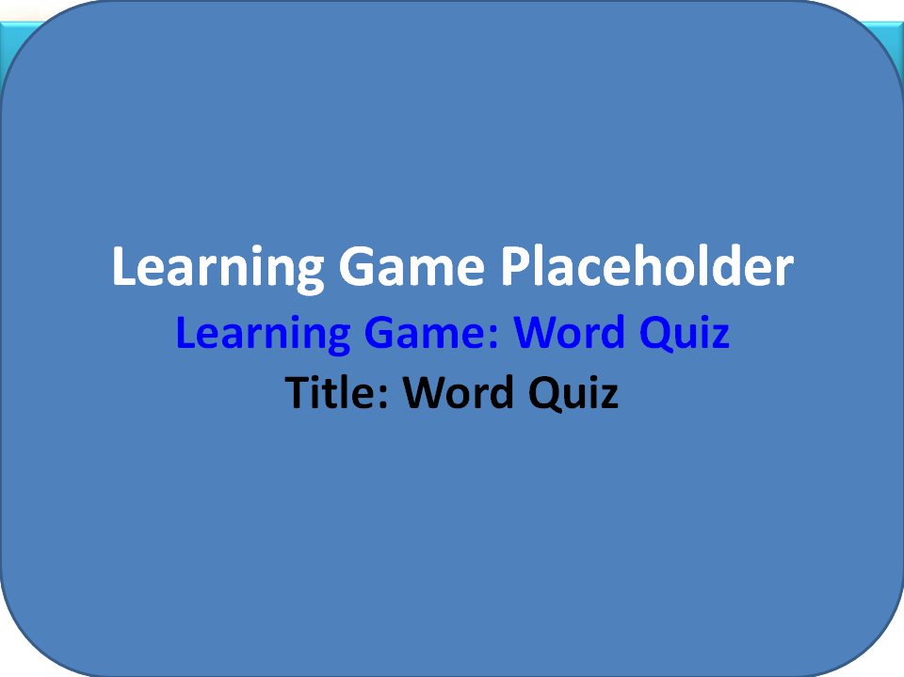

Slide 18
Module 2—Win Win Approach to CR
Opponents or Partners
The win/win approach is about changing the conflict from adversarial--attack and defense, to co-operation.
Notes:
The win/win approach is about changing the conflict from adversarial attack and defense, to co-operation.
It is a powerful shift of attitude that alters the whole course of communication.
One person consistently applying a joint problem-solving approach can make the difference. You, the reader, will probably be that person - redirecting the course of the conflict. Therefore, the first person you have to convince is yourself.
Until we give it attention, we are usually unaware of the way we argue. We often find ourselves with a knee-jerk reaction in difficult situations - based on long established habits combined with the passing mood of the moment. When challenged, we experience separateness, disconnectedness from those around us - a feeling of "you or me" - a sense that there isn't enough for both of us and if one person is right, then the other person must be wrong. Often we haven't taken even a moment to consider what is the best approach in the circumstances.
While people battle over opposing solutions "Do it my way!", "No, that's no good! Do it my way!", the conflict is a power struggle. What is needed is to change the agenda in the conversation. The win/win approach says:
I want to win and I want you to win too.
The challenge now is how to have this happen.
Go Back to needs
The most important win/win maneuver you can make is to change course by beginning to discuss underlying needs, rather than only looking at solutions. The following story makes the point quite well:
There are two people in a kitchen. There is only one orange left and both of them want it. What would you expect as the solution? Compromise is one option. They might cut it in half and each gets half.
Let's assume that's what they do. One person now goes to the juicer and starts squeezing herself a rather too small orange juice. The other, with some difficulty, begins to grate the rind of the orange to flavor a cake.
Had they discussed needs rather than heading straight to solutions, they could have both had the equivalent of a whole orange. Their needs were complementary, in fact, not conflicting. With the determination to use a win/win approach, two sets of needs can frequently dovetail together.
Addressing each person's underlying needs means you build solutions that acknowledge and value those needs, rather than denying them. Even where solutions cannot be as perfect as in the orange story, the person feels quite differently about the outcome.
To probe below the surface requires redirecting the energy. Ask questions like "Why does that seem to be the best solution to you?", "What's your real need here?", "What interests need to be served in this situation?", "What values are important to you here?", "What's the outcome or result you want?"
The answers to these questions significantly alters the agenda on the discussion table. It places there the right materials for co-operative problem-solving. It leads to opportunities for you to say what you need and for other people to say what they need too.
Win/win
I want to win and I want you to win too.
A win/win approach rests on strategies involving:
going back to underlying needs
recognition of individual differences
openness to adapting one s position in the light of shared information and attitudes
attacking the problem, not the people.
The Win/win approach is certainly ethical, but the reason for its great success is that IT WORKS. Where both people win, both are tied to the solution. They feel committed to the plan because it actually suits them.
Even when trust between the parties is very limited, the Win/Win Approach can be effective. If there's some doubt about the other person keeping their end of the bargain you can make the agreement reciprocal. "I'll do X for you, if you do Y for me." X supports their needs, Y supports yours. "I'll drive you to the party, if you clean the car." "I'll help you draw up those figures for your reports, if you sort out these invoice queries."
It's a successful strategy. Usually, co-operation can result in both people getting more of what they want. The Win/Win Approach is Conflict Resolution for mutual gain.

Slide 19
Learning Activity

Slide 20
Module 3—Creative Response
Problems or Challenges
Turning problems into possibilities.
Notes:
The Creative response to conflict is about turning problems into possibilities. It is about consciously choosing to see what can be done, rather than staying with how terrible it all is. It is affirming that you will choose to extract the best form the situation.
Our attitudes color our thoughts. Usually we are quite unaware of how they shape the way we see the world. Two dramatically contrasting attitudes in life are "Perfection" versus "Discovery". Let's call them attitude "hats". What "hat" do you get dressed in each day? Do you see difficulties as problems or as challenges?
The Perfection hat says: "Is this good enough or not?" (Usually not!) "Does this meet my impeccably high standards?"
The Discovery hat says: "How fascinating! What are the possibilities here?"
What is our mind chattering about under our Perfection hat?
Right or wrong?
Do I measure up?
Life is struggle.
Mistakes are unacceptable.
Judgment.
Unbendable beliefs about what's proper.
Failure!!
Do you measure up?
Life is hard work.
I have to be right.
Blame.
Don't take any chances
Low self-esteem!
The search for Perfection sets up: "Winners - & - Losers".
Such yardsticks can be used to make decisions about traffic jams, your partner, the kids, the copy machine, the boss and - above all - you.
Is there a Discovery hat still sitting on the shelf in your wardrobe of possibilities? You may hardly have worn it since you were a young child. When you learnt to walk you didn't go "right foot", "wrong foot". It was just right foot, left foot, and each fall was as interesting as the next step. To the young child, everything is part of the great experiment.
You can get out that hat again and dust it off. What's tucked away underneath your Discovery hat?
Exploration
Enthusiasm
Let's take a risk
What are the possibilities?
Everything's a success
Acceptance
Play
Inquiry
Experiment
How else can we look at this?
High self-esteem!
The process of Discovery invites: "Winners - & - Learners".
If there are no failures, only learning, self-esteem gets a big boost upwards. You can put on your Discovery hat and problems look like intriguing crossword puzzles. "What will make the difference so he stops complaining to me all the time?", "What else can I try to get the kids to help with washing up?", "What are we freed up to do now that $7 million order has just been cancelled?", "How fascinating, the copy machine has broken down again!"
The process of Discovery invites: "Another Challenge? How Fascinating!"
Errors can be regarded as splendid opportunities for learning. We are at our most energized as we stand ready to act on the edge of our personal unknowns. But that means we're going to make some mistakes. To tap the benefits of initiative, we really need to play down our judgment and criticism. Of course, we need to acknowledge errors and go through a correcting process. But when we move to discovery mode, we're not overly cautious about making mistakes and we don't make other people too cautious to act resourcefully by being overly critical. When an organization encourages the willingness to risk in its employees, it gets an alive and motivated staff.
A not-so-famous but should be maxim: "If a thing's worth doing, it's worth doing badly!" is an invitation to experiment and risk.
Robert Kyosaki in his "Money and You" workshops often relates the very telling story of the IBM company in the States. One middle executive there made a tactical error that cost the company $9 million. The following week the executive, sure he was about to be fired, was called into the office of the Chairman. The Chairman started discussing plans for a huge new project that he wanted the executive to direct. After a certain point, the executive was feeling so uncomfortable he had to stop the Chairman: "Excuse me, sir, you know I'm amazed. Last week I cost us $9 million. Why are you putting me in charge of this new project? I thought you were going to fire me." The Chairman smiled. "Fire you? Young man, I've just invested $9 million educating you. You're now one of my most valuable assets." Here was a chairman who valued the willingness to risk and learn. He knew it was an essential ingredient in the successful executive.
Life is not about winning and losing - it's about learning. When you fall down, you pick yourself up and note where the pot-hole was so you can walk around it the next time. A person who has gone "too far" knows just how far they can go. No "winners - and - losers", just "winners - and - learners".

Slide 21
Learning Assessment
This is the end of Modules 2-3.
Complete the Quiz on the next slide to move on to Module.

Slide 22
Learning Activity

Slide 23
Module 4--Empathy
The Task of Active Listening
Rapport and openness between people.
Notes:
Empathy is about rapport and openness between people. When it is absent, people are less likely to consider your needs and feelings. The best way to build empathy is to help the other person feel that they are understood. That means being an active listener. There are three specific listening activities relevant to different situations - 1. information, 2. affirmation and 3. inflammation.
1. Information - getting a clear picture
AIM OF SPEAKER: to get across what is wanted so there is no confusion.
TASK OF LISTENER: to get the details, to check out and confirm what the speaker is saying and get clear on anything relevant they might be forgetting to say.
When you move into active listening mode to get information you are trying to find out about needs, instructions and perhaps background information.
ASK QUESTIONS - Find out about needs, instructions, context, timing, costs etc.
CHECK BACK - to be sure you have heard and understood the relevant details.
SUMMARISE - to make sure you both agree on the facts.
As listener you are trying to get your speaker to say something like: "Yes, that's what I want" so you are both clear.
Don't jump straight into solutions. Collect information. Find out how it is on the other side first.
Enquire about their needs in the situation.
Enquire about their concerns, anxieties or difficulties.
Find out their view of the needs and concerns of other relevant people affecting the situation.
Ask general questions that encourage them to open up e.g. How do you see it all?
Ask specific questions that will give you significant pieces of information e.g. How much does it cost?
Explore hidden premises on which they build their thinking.
If they say "I can't" you might ask "What happens if you do?"
If they say "They always..." you might ask "Are there any circumstances in which they don't?"
If they say "It's too many, or too much" or "It's too little or too few" you might ask "compared with what?"
2. Affirmation - affirming, acknowledging, exploring the problem.
AIM OF SPEAKER: to talk about the problem.
TASK OF LISTENER: to help the speaker really hear what the speaker is saying and for the speaker to hear that you acknowledge their feelings.
Here you are recognizing that the other person would be helped by you taking time to hear their problem.
LISTEN - attentively to the speaker.
REFLECT BACK - to the speaker their feelings, and perhaps the content of the problem with a single statement of acknowledgement periodically.
EXPLORE - If time permits, assist the speaker in finding greater clarity and understanding for themselves. You might take several interchanges reflecting back the speaker's feelings over a longer period of time, so that you both the difficulty in more depth. To get a "Yes, that's what I feel" so they explore what they are saying and they know they've been understood.
Use active listening when offering advice won't really help. The speaker would be best served by finding greater clarity and understanding of the problem for themselves. Active listening builds relationship.
Don't ignore or deny their feelings.
Read the non-verbal as well as the verbal communication to assess feelings.
Check back with them about their feelings as well as the content even though they may only be telling you about the content.
If you're not sure how they feel, ask them e.g. "How do you feel about that?", "How did that affect you?"
Reflect back to them what you hear them to be saying so they can hear themselves.
Reflect back to them what you hear them to be saying so they know you understand.
If you get it wrong, ask an open question and try again e.g. "How do you see the situation?"
When time permits: direct the conversation back to the point if the person drifts to a less significant topic because they feel you don't understand. Allow some silences to grow in the conversation if appropriate. Thoughtful silence can be fertile ground.
Remember that your active listening is a method of helping the other person focus below the words to the unresolved issues.
Notice sighs and body shifts. They'll often indicate some insight or acceptance. Pause before asking something like "How does it all seem to you now?"
3. Inflammation - responding to a complaint or attack on you
AIM OF SPEAKER: to tell you that you are the problem.
TASK OF LISTENER: to let the speaker know you've taken in what they are saying and to defuse the strong emotion.
When someone is attacking you verbally, moving into active listening mode is usually the most useful response you can make. When there is conflict it's very common to blame the other person. It is difficult to be objective when the emotional level is high. Active listening is an effective tool to reduce the emotionality of a situation. Every time you correctly label an emotion the other person is feeling, the intensity of it dissipates. The speaker starts to feel heard and understood. Once the emotional level of the conflict has been reduced, reasoning abilities for both of you can function more effectively. When someone is telling you they are unhappy with you, criticizing you, complaining about you, or just getting it off their chest:
DON'T DEFEND yourself at this point. It will inflame them further.
DEAL FIRST WITH THEIR EMOTIONS - People shout because they don't think they are being heard. Make sure they know they are - that you are hearing how angry or upset they are. Label accurately the emotions/feelings as you perceive them.
ACKNOWLEDGE THEIR SIDE - This does not mean you agree with them, only that you are registering their viewpoint e.g. "I can see, if you think that was my attitude, why you are so angry", "I can see why the problem makes you so upset".
Draw them out further. Explore gently with them if there is more behind the emotion.
Once the heat is out of the conversation, you might say how it is for you without denying how it is for them.
Ask what could be done now to make it OK again. If they heat up again, go straight back to active listening.
Move towards options for change or solution. Ask what they really want, or what they want now.
The listener is working towards the speaker saying something like: "Yes, that's what I said" so that the speaker knows the listener has taken in their point.
For them to change first I must change.
One of the first things I might need to change is my approach.
Don't rise to the bait, and retaliate.
Don't start justifying.
Don't act defensive.
Go into active listening mode and stay there till they've calmed down.
Use phrases like "It's making you really mad", "I can see how upset you are", "You feel like you've reached your limit", "Have I got it right?", "So when I do... you get really frustrated with me."
Keep on reflecting back as accurately as you can until they come down from the high emotion. If you are doing it right, they will explain everything in some detail, but as the interchange continues the heat should be going out of the conversation.

Slide 24
Learning Activity

Slide 25
Module 5—Appropriate Assertiveness
When to use “I” Statements
Stating your case without arousing the defenses of the other person.
Notes:
When to use "I" statements
The essence of Appropriate Assertiveness is being able to state your case without arousing the defenses of the other person. The secret of success lies in saying how it is for you rather than what they should or shouldn't do. "the way I see it...", attached to your assertive statement, helps. A skilled "I" statement goes even further.
When you want to state your point of view helpfully, the "I" statement formula can be useful. An "I" statement says how it is on my side, how I see it.
You could waste inordinate quantities of brain power debating how the other person will or won't respond. Don't! You do need to be sure that you haven't used inflaming language, which would be highly likely to cause a negative response i.e. it should be "clean". Because you don't know beforehand whether the other person will do what you want or not, the cleanest "I" statements are delivered not to force them to fix things, but to state what you need.
Use an "I" statement when you need to let the other person know you are feeling strongly about the issue. Others often underestimate how hurt or angry or put out you are, so it's useful to say exactly what's going on for you - making the situation appear neither better nor worse i.e. your "I" statement should be "clear".
What Your "I" Statement Isn't
Your "I" statement is not about being polite. It's not to do with "soft" or "nice", nor should it be rude. It's about being clear.
It's a conversation opener, not the resolution. It's the opener to improving rather than deteriorating relationships.
If you expect it to be the answer and to fix what's not working straight away - you may have an unrealistic expectation.
If you expect the other person to respond as you want them to immediately, you may have an unrealistic expectation.
What you can realistically expect is that an appropriate "I" statement made with good intent.
is highly unlikely to do any harm
is a step in the right direction
is sure to change the current situation in some way
can/will open up to possibilities you may not yet see.
Sometimes the situation may not look any different yet after a clean, clear "I" statement it often feels different, and that on its own can change things. Here's an example:
Nan was upset when she heard her adult son, Tommy, had visited town and not bothered to call or see her. They seemed to be growing further apart, and she had been brooding over this. She did not want to appear to nag him, or say anything to make things worse. She did want to see him when he came to town.
When next they spoke, instead of putting on her "pretending not to be hurt" voice, she prepared herself for the conversation with a well rehearsed "I" statement. She got it "clear" and "clean". She was very sure she wanted a conversation that would be different from all those times she hinted at the problem without really saying it.
"When I miss out on seeing you I feel hurt and what I'd like is to have contact with you when you are in town."
She said it. Tommy immediately reacted with "You're always going at me with the same old thing."
But Nan had a clear intention. "No", she said. "This time I said something different. I was simply telling you how I feel."
For the first time on this issue, he really heard her. There was a moment's silence. Then instead of getting defensive (his usual pattern) he said "Well, actually I've tried to phone a few times. You weren't home." She acknowledged that was so. She felt much better and they then went on to have the best conversation in ages.
The next time someone shouts at you and you don't like it, resist the temptation to withdraw rapidly (maybe slamming the door on the way out). Resist the temptation to shout back to stop the onslaught, and deal with your own rising anger.
This is the time for APPROPRIATE ASSERTIVENESS. Take a deep breath. Stay centered, feet firmly planted on the ground, and get your mind into "I" statement gear. Start mixing a three ingredient recipe:
When... I hear a voice raised at me
I feel... humiliated
And what I'd like is that I... can debate an issue with you without ending up feeling hurt.
The best "I" statement is free of expectations. It is delivering a clean, clear statement of how it is from your side and how you would like it to be.
5. Co-operative power
Responding to resistance from others
When faced with a statement that has potential to create conflict, ask open questions to reframe resistance. Explore the difficulties and then re-direct discussion to focus on positive possibilities.
Explore - Clarify details
It's too expensive. Compared to what? Too many/much/little/few. Compared to what? I want the best. What would be best for you? Find options
You can't do that around here. What would happen if we did? He (she) would never...How can we find ways for it to happen? They always...Are there any times they don't? We've tried that already. What was the outcome? This is the only way to do it Yes, that's an option. What else could we consider? Redirect - Move to the positive
It will never work. What would it take to make it work? I won't...What would make you willing? It's a failure. How could it work? It's disastrous. What would make it better? He's (she's) useless. What is he (she) doing that is acceptable? It's impossible. What would it take to make it possible? I can't. You can't see a way to do it at the moment? I don't want to. What would you like? Go back to legitimate needs and concerns
He's (she's) a hopeless case! It's hard to see how to work with him (her)?You fool (and other insults)!What do we need to do to sort this out? How dare you do such a thing! What do you dislike about it? It should be done my way. What makes that seem the best option? His/her place is a pig's sty! He/she puts a different emphasis on tidiness to you? He/she doesn't do their fair share. Where do you think his/her priorities may lie?
6. Managing emotions
Handling yourself
5 Questions + 5 Goals
Don't indulge
Don't deny
Create richer relationships
Print out the questionnaire below to complete the following:
Five questions
when angry/hurt/frightened
Why am I feeling so angry/hurt/frightened?
What do I want to change?
What do I need in order to let go of this feeling?
Whose problem is this, really? How much is mine? How much is theirs?
What is the unspoken message I infer from the situation? (e.g. they don't like me, they don't respect me.)
Five goals
in communicating emotions
Aim to avoid the desire to punish or blame. Action?
Aim to improve the situation. Action?
Aim to communicate your feelings appropriately. Action?
Aim to improve the relationship and increase communication. Action?
Aim to avoid repeating the same situation. Action?
If communication is not appropriate, what other action can I take?
Managing emotions - part 2
Handling others
People's behavior occurs for a purpose. They are looking for ways to belong, feel significant, and self-protect. When people perceive a threat for their self-esteem, a downward spiral can begin. People can be led into obstructive behaviors in the faulty belief that this will gain them a place of belonging and significance. How we respond to their difficult behaviors can determine how entrenched these become.
The secret is to break out of the spiral by supporting their real needs without supporting their destructive faulty beliefs, and alienating patterns of reaction.
Difficult Behavior(and the Faulty Belief Behind It)The Downward Spiral Better Alternatives Seeking Attention ("I only belong when I am being noticed."),You feel annoyed and react by coaxing. They stop briefly, and then resume behavior and demands,, perhaps in a new way. Avoid undue attention. Give attention for positive behavior especially when they are not making a bid for it. Support their real contribution and involvement. Power Plays("I only belong when I am in control, when no-one can boss me!").You feel provoked or threatened and react by fighting or giving in. Their aggression is intensified or they comply defiantly. Disengage from the struggle. Help them to use power constructively by enlisting co-operation. Support their self-worth and autonomy. Seeking Revenge ("I am significant only if I make others feel hurt like I do.")You feel hurt by them, and retaliate. They seek further revenge more strongly or with another weapon. Convince them that you respect their needs. Build trusting relationships. Support their need for justice and fairness. Appear Inadequate ("I won't be hurt any more, only if I can convince others not to expect much from me.")You give up, overwhelmed. They respond passively, show no improvement, and stay "victim". Encourage any positive attempt, no matter how small. Focus on assets. Provide bite-sized learning experiences they can succeed at. Support how they feel as a starting place for self-improvement.

Slide 26
Learning Activity

Slide 27
Learning Assessment
This is the end of Modules 4-5.
Complete the Quiz on the next slide to move on to Module.

Slide 28
Module 6—Co-Operative Power
Responding to resistance from others
Ask open questions to reframe resistance.
Notes:
6. Managing emotions--Handling yourself
5 Questions + 5 Goals
Don't indulge
Don't deny
Create richer relationships
Print out the questionnaire below to complete the following:
Five questions
when angry/hurt/frightened
Why am I feeling so angry/hurt/frightened?
What do I want to change?
What do I need in order to let go of this feeling?
Whose problem is this, really? How much is mine? How much is theirs?
What is the unspoken message I infer from the situation? (e.g. they don't like me, they don't respect me.)
Five goals
in communicating emotions
Aim to avoid the desire to punish or blame. Action?
Aim to improve the situation. Action?
Aim to communicate your feelings appropriately. Action?
Aim to improve the relationship and increase communication. Action?
Aim to avoid repeating the same situation. Action?
If communication is not appropriate, what other action can I take?
Managing emotions - part 2
Handling others
People's behavior occurs for a purpose. They are looking for ways to belong, feel significant, and self-protect. When people perceive a threat for their self-esteem, a downward spiral can begin. People can be led into obstructive behaviors in the faulty belief that this will gain them a place of belonging and significance. How we respond to their difficult behaviors can determine how entrenched these become.
The secret is to break out of the spiral by supporting their real needs without supporting their destructive faulty beliefs, and alienating patterns of reaction.
Difficult Behavior(and the Faulty Belief Behind It)The Downward Spiral Better Alternatives Seeking Attention ("I only belong when I am being noticed."),You feel annoyed and react by coaxing. They stop briefly, and then resume behavior and demands,, perhaps in a new way. Avoid undue attention. Give attention for positive behavior especially when they are not making a bid for it. Support their real contribution and involvement. Power Plays("I only belong when I am in control, when no-one can boss me!").You feel provoked or threatened and react by fighting or giving in. Their aggression is intensified or they comply defiantly. Disengage from the struggle. Help them to use power constructively by enlisting co-operation. Support their self-worth and autonomy. Seeking Revenge ("I am significant only if I make others feel hurt like I do.")You feel hurt by them, and retaliate. They seek further revenge more strongly or with another weapon. Convince them that you respect their needs. Build trusting relationships. Support their need for justice and fairness. Appear Inadequate ("I won't be hurt any more, only if I can convince others not to expect much from me.")You give up, overwhelmed. They respond passively, show no improvement, and stay "victim". Encourage any positive attempt, no matter how small. Focus on assets. Provide bite-sized learning experiences they can succeed at. Support how they feel as a starting place for self-improvement.

Slide 29
Learning Activity

Slide 30
Module 7—Managing Emotions
Handling yourself
5 Questions and 5 Goals
Notes:
7. Willingness to resolve
Projection and shadow
Does the situation inform or inflame?
The Opportunity
The more someone inflames me, angers or upsets me, the more I know I have something to learn about myself from that person. In particular, I need to see where projection from my shadow side has interfered with my willingness to resolve.
Projection
Projection is when we see our own thoughts and feelings in the minds and behavior of others and not in ourselves. We push something about ourselves out of our awareness and instead see it coming towards us from others. We see that X is angry with us and we feel hurt. We don't recognize that we are angry with X and would like to hurt X. It's very similar to film projection. The movie going on in our heads is projected out onto the people around us. Each of us builds, in this way, a highly personalized world. Greater self- awareness is necessary if we are to see reality.
Persona and shadow
Psychologist, Carl Jung, used the word "Persona" to describe the conscious aspects of personality, good and bad aspects which are known to the person. Jung called the unknown side of who we are "shadow".
Persona: My self-image. Things I accept are true about myself. My conscious desires, wants, feelings, intentions and beliefs. Shadow: Potential I have not unfolded. Aspects of myself I'm not ready to know about. My unconscious wants and dislikes. Emotional responses that are too painful to fully experience. Abilities/ talents I'm not ready to accept or express. Shadow hugging and boxing
Extreme attachment or rejection are both signs that our shadow has us in its hold. If we are overly attached to someone because of desirable qualities that we see in him/her and deny in ourselves we are SHADOW HUGGING. If we are overly rejecting of undesirable qualities in someone or something that we deny in ourselves we are SHADOW BOXING.
The hook the behavior in the other person that is inflaming me, is in itself a neutral event. My projection gets caught on this hook. The symptom my emotional reaction (usually variations on anger or hurt).The projection the part of my shadow that is causing my strong reaction. Acknowledgement
To be willing to resolve, we need to acknowledge our projection. Consider:
Suppressed needs e.g. Failing to recognize my need for companionship, I am deeply hurt when a friend postpones time we'd planned to be together.
Unresolved personal history e.g. If I was seriously let down as a child I may become really wild when people don't do what they promised.
Unacceptable qualities e.g. Because I don't accept my own anger, I don't accept it in others.

Slide 31
Learning Activity

Slide 32
Learning Assessment
This is the end of Modules 6-7.
Complete the Quiz on the next slide to move on to Module.

Slide 33
Module 8—Willingness to Resolve
Projection and Shadow
Does the situation inform or inflame?
Notes:
8. Mapping the conflict
Define briefly the issue, the problem area, or conflict in neutral terms that all would agree on and that doesn't invite a "yes/no" answer e.g. "Filing" not "Should Sal do filing?"
Alongside Who: write down the name of each important person or group.
Write down each person's or group's needs. What motivates him/her?
Write down each person's or group's fears, concerns, or anxieties.
Be prepared to change the statement of the issue, as your understanding of it evolves through discussion or to draw up other maps of related issues that arise. You may need more space for writing all the significant needs and fears than the table below allows.
Issue:
Who:
Needs:
Fears:
Who:
Needs:
Fears:
Who:
Needs:
Fears:
Who:
Needs:
Fears:

Slide 34
Learning Activity

Slide 35
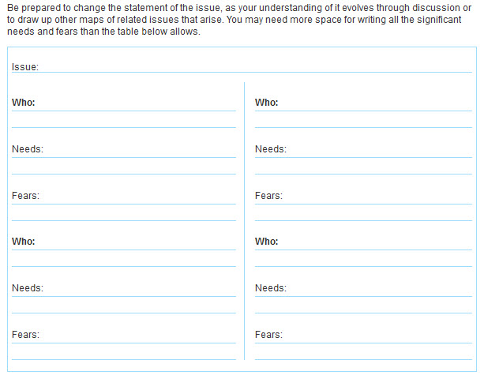
Module 9—Mapping the Conflict
Notes:
What are the range of options? Use the tools below to generate ideas.
Clarifying tools
Chunking - breaking the problem into smaller parts.
Researching - more information; extent of resources: constraints.
Goal-setting - what is the outcome we want?
Generating tools
The obvious solution - to which all parties say "yes".
Brainstorming- no censoring, no justifying, no debating
Consensus - build a solution together
Lateral thinking - have we been practical, creative?
Negotiating tools
Maintain current arrangements - with trade-offs or sweeteners.
Currencies - what is it easy for me to give and valuable for you to receive?
Trial and error - try one option, then another
Establishing alternatives - what will happen if we can't agree?
Consequences confrontation - what I will do if we don't agree.
Selection
Consider:
Is it built on a win/win approach?
Does it meet many needs of all parties?
Is it feasible?
Is it fair?
Does it solve the problem?
Can we settle on one option or do we need to trial several?

Slide 36
Learning Activity

Slide 37
Learning Assessment
This is the end of Modules 8-9.
Complete the Quiz on the next slide to move on to Module.

Slide 38
Module 10—Development of Options
What are the range of options?
Clarifying tools
Chunking - breaking the problem into smaller parts.
Researching - more information; extent of resources: constraints.
Goal-setting - what is the outcome we want?
Generating tools
The obvious solution - to which all parties say "yes".
Brainstorming- no censoring, no justifying, no debating
Consensus - build a solution together
Lateral thinking - have we been practical, creative?
Negotiating tools
Maintain current arrangements - with trade-offs or sweeteners.
Currencies - what is it easy for me to give and valuable for you to receive?
Trial and error - try one option, then another
Establishing alternatives - what will happen if we can't agree?
Consequences conformation - what I will do if we don't agree.
Notes:
Five basic principles
Be hard on the problem and soft on the person
Focus on needs, not positions
Emphasize common ground
Be inventive about options
Make clear agreements
Where possible prepare in advance. Consider what your needs are and what the other person's are. Consider outcomes that would address more of what you both want. Commit yourself to a win/win approach, even if tactics used by the other person seem unfair. Be clear that your task will be to steer the negotiation in a positive direction. To do so you may need to do some of the following:
Reframe
Ask a question to reframe. (e.g. "If we succeed in resolving this problem, what differences would you notice?" Request checking of understanding. ("Please tell me what you heard me/them say.") Request something she/he said to be re-stated more positively, or as an "I" statement. Re-interpret an attack on the person as an attack on the issue.
Respond not react
Manage your emotions.
Let some accusations, attacks, threats or ultimatums pass.
Make it possible for the other party to back down without feeling humiliated (e.g. by identifying changed circumstances which could justify a changed position on the issue.)
Re-focus on the issue
Maintain the relationship and try to resolve the issue. (e.g. "What's fair for both of us?" Summaries how far you've got. Review common ground and agreement so far. Focus on being partners solving the problem, not opponents. Divide the issue into parts. Address a less difficult aspect when stuck. Invite trading ("If you will, then I will") Explore best and worst alternatives to negotiating an acceptable agreement between you.
Identify Unfair Tactics
Name the behavior as a tactic. Address the motive for using the tactic. Chance the physical circumstances. Have a break. Change locations, seating arrangements etc. Go into smaller groups. Meet privately. Call for meeting to end now and resume later, perhaps "to give an opportunity for reflection".

Slide 39
Learning Activity

Slide 40
Module 11—Introduction to Negotiation
5 Basic Principles
Be hard on the problem and soft on the person
Focus on needs, not positions
Emphasize common ground
Be inventive about options
Make clear agreements
Notes:
These attitudes are relevant whenever you want to advise, in a conflict which is not your own. It may be a friend telling you about a problem on the telephone. It may an informal chat with both conflicting people. It may be a formally organized mediation session.
Be objective - validate both sides, even if privately you prefer one point of view, or even when only one party is present.
Be supportive - use caring language. Provide a non-threatening learning environment, where people will feel safe to open up.
No judging - actively discourage judgments as to who was right and who was wrong. Don't ask "Why did you?" Ask "What happened?" and "How did you feel?"
Steer process, not content - use astute questioning. Encouraging suggestions from participants. Resist advising. If your suggestions are really needed, offer as options not directives.
Win/win - work towards wins for both sides. Turn opponents into problem-solving partners.
Mediation Methods
Use the simple, yet effective rules from the "Fighting Fair" poster.
Define your mediator role as there to support both people "winning".
Get agreement from both people about a basic willingness to fix the problem.
Let each person say what the problem is for them. Check back that the other person has actually understood them.
Guide the conversation towards a joint problem solving approach and away from personal attack.
Encourage them to look for answers where everybody gets what they need.
Redirect "Fouls" (Name Calling, Put Downs, Sneering, Blaming, Threats, Bringing up the Past, Making Excuses, Not Listening, Getting Even). Where possible you reframe the negative statement into a neutral description of a legitimate present time concern.
Steps in Mediation
Open Introductions and agreements Warm up, explanations, agenda if known. Establish Overview: What is the matter? Each person to express their view of the conflict, the issues and their feelings.
Details: What is involved? More details. Map needs and concerns. Clarify misperceptions. Identify other relevant issues. Mirroring if needed.
Move: Where are they now? Identify areas of agreement. Encourage willingness to move forward. Caucus if needed.
Negotiation: Focus on future action. How would they like it to be? What would that take? Develop options. Trading - build wins for everyone.
Close Completion: Contracting. Plans for the future, including appointed time to review agreement. Closing statements.

Slide 41
Learning Activity

Slide 42
Learning Assessment
This is the end of Modules 10-11.
Complete the Quiz on the next slide to move on to Module.

Slide 43
Module 12—Introduction to Mediation
Attitudes for mediators
Attitudes are relevant
Notes:
Respect and value differences
Just as we are unique and special, so are other people. We all have distinctive viewpoints that may be equally valid from where we stand. Each person's viewpoint makes a contribution to the whole and requires consideration and respect in order to form a complete solution. This wider view can open our eyes to many more possibilities. It may require us to change the mind chatter that says: "For me to be right, others must be wrong."
Recognize a long term timeframe.
Consider how the problem or the relationships will look over a substantial period of time. The longer timeframe can help us be more realistic about the size of the problem we presently face.
Assume a global perspective.
If we believe that the actions of one individual are interconnected with every other individual, then we can have a sense how our actions can have meaning in conjunction with the actions of others. We can look at the overall system, which may be the family, the organization or the society. Consider what needs this larger unit has in order to function effectively.
Deal with resistance to the broader perspective
Taking up a broader view can be scary. It may make us less certain of the rightness of our own case. We may fear that we will lose all conviction to fight for what we need. We may have to give up the security we got from the simple way we previously saw the problem. We may need courage to enter the confusion of complexity. Many fears of taking the broader perspective prove ungrounded once we analyze them carefully.
Open to the idea of changing and risk-taking
By taking a broader perspective you may be confronted with the enormity of the difficulties. Identify what you can do to affect a particular problem, even if it is only a small step in the right direction. One step forward changes the dynamics and new possibilities can open up.

Slide 44
Learning Activity

Slide 45
Module 13—Broadening Perspectives
Respect and Value Differences
We are unique and special, so are other people.

Slide 46
Learning Activity

Slide 47
Learning Assessment

Slide 48
Conclusion
Congratulations, you have reached the end of the Modules.
Complete the Quiz on the next slide to complete the course.

