Slide 1
Advisory Services Retirement Readiness Products and Services Enhancements
Notes:
Welcome to the Advisory Services Retirement Readiness Products and Services Enhancements course!

Slide 2
Topics
Introduction
Purpose of course
Objectives
Overview
Define AUA to AUM
Define Advisory Services
Current AUM (Managed Accounts) - Five Year Goal
Advisory Services Voluntary Enrollment Enhancements
Business Strategy and Components
Free Look Period, Offer Letter, Retirement Readiness Report Card, Education Center
What is it?
To whom is it being offered?
What are strategy, positioning and value?
Roles & Responsibilities
The Re-Engineered Managed Account Opt-Out Enrollment Process
What is it?
To whom is it being offered?
What are the strategy, positioning and value?
Summary
Notes:
In this course, we will cover:
an Introduction

Slide 3
Introduction

Slide 4
Purpose
The purpose of this course is to give an overview of the Advised Assets Group (AAG) Advisory Services Retirement Readiness Products and Services Enhancements and the Re-Engineered Managed Account Opt-Out Enrollment Process and explain why it is important to plan sponsors, participants, and your team.
Notes:
The purpose of this course is to give an overview of the Advised Assets Group (AAG) Advisory Services Retirement Readiness Products and Services Enhancements and the Re-Engineered Managed Account Opt-Out Enrollment Process and explain why it is important to plan sponsors, participants, and your team

Slide 5
Objectives
At the end of this course, you should be able to:
Define Advisory Services
Explain the Advisory Services Retirement Readiness Products and Services Enhancements
Describe the strategy, positioning, and value of the Advisory Services Retirement Readiness Products and Services Enhancements components
Explain the roles and responsibilities associated with this initiative
Define the Re-Engineered Managed Account Opt-Out Enrollment Process
Describe the strategy, positioning, and value of the Re-Engineered Managed Account Opt-Out Enrollment Process
Notes:
At the end of this course, you should be able to:
Define Advisory Services
Explain the Advisory Services Retirement Readiness Products and Services Enhancements
Describe the strategy, positioning, and value of the Advisory Services Retirement Readiness Products and Services Enhancements components
Explain the roles and responsibilities associated with this initiative
Define the Re-Engineered Managed Account Opt-Out Enrollment Process
Describe the strategy, positioning, and value of the Re-Engineered Managed Account Opt-Out Enrollment Process

Slide 6
Overview
2nd Century AUA to AUM Initiative
The primary objectives of this initiative are:
Attract plan dollars into managed investment products and services
Drive increased utilization rates of:
Proprietary Investment Funds and Asset Allocation solutions
Advisory Services
General Account Products
Introduce new investment products, services, and/or processes allowing capture of an increased percentage of in-force and/or new sale AUA into AUM
Notes:
The Advisory Services Retirement Readiness Products and Services Enhancements and the Re-Engineered Managed Account Opt-Out Enrollment Process have been driven by the 2nd Century initiative AUA to AUM, or Assets Under Administration to Assets Under Management.
The primary objectives of this initiative are to:
Attract a greater share of plan dollars into managed investment products and services.
Drive increased utilization rates of:
Proprietary Investment Funds and Asset Allocation solutions
Advisory Services
General Account Products
Introduce new investment products, services, and/or processes that allow capture of an increased percentage of in-force and/or new sale AUA into AUM

Slide 7
Overview
What Is Advisory Services?
Provides opportunity for plan participants to receive investment assistance
Accumulation of savings stage
Distributions after retirement stage (spend down)
Provides investment advisory tools and services
Understand how much money is needed during retirement
Design a retirement plan strategy to meet retirement goals
Provide investment advice strategies during retirement
Different levels of help available based on:
investment goals
time horizon
investor profile
tolerance for risk
Lets plan participant choose the level of help
Notes:
What is Advisory Services?
Advisory Services provides participants with the opportunity to receive investment assistance, from the accumulation of savings stage through distributions on your accounts after retirement, or the spend-down stage.
Advisory Services provides investment advisory tools and services to plan participants based upon the level of involvement they desire in managing their investments.
These tools may help you have a better understanding of how much money you’ll need during retirement, help design a retirement plan strategy to meet that goal, and provide investment advice strategies during retirement. The Advisory Services’ Spend-Down Advice feature can also recommend the implementation of the SecureFoundationSM Guaranteed Lifetime Withdrawal benefit into your portfolio if that option is available in your Plan (add GLWB reference).
Advisory Services recognizes that most of us aren’t investment professionals or retirement planning experts and offers choices as to the level of assistance a participant might want. We recognize that no two plan participants are the same. Some people really enjoy being actively involved in making day-to-day decisions about their investments; some people may not have the time, interest or confidence to make those decisions; and some may just want the convenience of having someone take care of their investment decisions for them.
Advisory Services lets the plan participant choose the level of help that they want in making the choices in their plan. They can have as much or as little help as they need.
Advisory Services-2

Slide 8
Overview
Advisory Services Retirement Readiness Products and Services Enhancements :
Goals and Objectives
Identify the strategy for increased voluntary enrollment into AUM to reach 5-year AUM revenue goals
Seeks to educate plans, sponsors and participants regarding value of Advisory Services
Provides a different retirement readiness analysis:
Participant initiated to plan sponsor directed
Saving for an unknown “nest egg” to goal planning
Uncertain retirement income to strategic spend down strategies and guaranteed income products
Notes:
The goals and objectives of the Advisory Services Retirement Readiness Products and Services Enhancements initiative are to:
Identify the strategy for increased voluntary enrollments into AUM to reach five-year revenue goals
Educate plans, sponsors and participants regarding the value of the Advisory Services
This initiative provides something different than the traditional approach with a shift:
From participant initiated, determined and executed retirement strategies to plan sponsor directed, defaulted, escalated and “nudged”
From saving for an unknown “nest egg” to goal planning for a desired retirement age and income replacement
From uncertainty in ability for assets to provide income for a lifetime to advice on optimizing spend down strategies and maximizing retirement income with advice to guaranteed income products

Slide 9
Learning Activity #1
Identify the following statements as either true or false.
One of the 2nd Century AUA to AUM Initiative’s primary objectives is to drive increased utilization rates of Advisory Services.
True
False
Advisory Services provides the opportunity for plan participants to receive investment assistance only during the accumulation of savings stage.
True
False
Advisory Services provides investment advisory tools and services to you based upon the level of involvement you desire in managing your investments.
True
False
Answers are in shaded boxes.
Notes:
Identify the following statements as either true or false.

Slide 10
Advisory Services Retirement Readiness Products and Services Enhancements

Slide 11
Business Strategy & Components
Strategy – Awareness, Action, Progress
Create Value Awareness
Drive Action
Monitor & Report Progress
Offer Letter
Free Look Period
Participant Website
Participant Statements
Statement Stuffers
Welcome Kit
Call to Action
(via Offer Letter)
Education Center
Participant Retention
Program
Opt-Out Process
Plan Sponsor Retirement Readiness Report Card
Participant Website
Participant Statements
Competitive Insight
Annual Kit
Mail
Online
Field
Call Center
Notes:
We’ve broken the business strategy down into different areas in order to:
Create value awareness
Drive action
And monitor and report progress.
Looking at each area in more detail:
The process to create value awareness is broken up into the individual initiatives that we will discuss throughout this training.
We plan to use these initiatives as a clear call to action to all plan participants and plan sponsors.
We plan to monitor and report this progress as a way to report the success of the AUA to AUM initiatives.

Slide 12
Business Strategy & Components
Aim to increase and retain plan and participant enrollments through the following programs:
Retirement Readiness Report Card
Offer Letter
Free Look Period
Education Center
Re-Engineered Managed Account Opt -Out Enrollment Process
Notes:
The aim of the Advisory Services Retirement Readiness Products and Services Enhancements initiative is to increase and retain plans and participant enrollments through the following programs:
The Retirement Readiness Report Card
Offer Letter
Free Look Period
An Education Center
Key Plan Approach
Participant Retention Program
And the Re-Engineered Managed Account Opt -Out Enrollment Process
We’re going to go over each of these initiatives in more detail and we will answer three important questions:
First, what is it?
Second, to whom is it being offered?
And finally, what are the strategy, positioning and value of each program?

Slide 13
Retirement Readiness Report Card
What is it?
Tool to measure and analyze participant retirement readiness
Provides in-depth reporting metrics to assist plan sponsors in fulfilling their fiduciary
Identifies opportunities for improving retirement readiness
To whom is it being offered?
Plan sponsors
What are the strategy, positioning and value?
Brings awareness to plan sponsor of specific participant behavior
Identifies potential strategies to increase retirement readiness
Provides information regarding Advisory Services plan-specific portfolios and rate of return information
Generates consultative discussions regarding:
Potential plan design changes
Investment lineup additions
Participant communication, education or beneficial Advisory Services programs
Notes:
The first component of the initiative is the Retirement Readiness Report Card.
AAG is very excited about the Retirement Readiness Report Card. We will spend quite a bit of time here explaining the benefits.
Let's start with:
What is it?
The Retirement Readiness Report Card is a tool provided to the plan sponsor to measure and analyze participant retirement readiness
It will assist the plan sponsor in fulfilling their fiduciary duties by measuring, tracking and reporting metrics regarding retirement “financial health” of the participants in their plan.
It also it helps identify possible opportunities for improving the retirement readiness of the plan participants.
To whom is it being offered?
This component is offered to plan sponsors
What are the strategy, positioning and benefits?
The Retirement Readiness Report Card brings awareness to the plan sponsor of specific shortcomings of participant behavior.
Identifies strategies to increase the potential for employees to achieve 100% income replacement in retirement.
Assists plan sponsors in reporting information regarding Advisory Services plan specific portfolios and plan summary statistics and rate of return by investment allocation assistance level
On the plan level, this tool generates consultative discussion regarding:
Potential plan design changes and
Investment lineup additions
And on the participant level, this tool uncovers additional communication, education or advisory services programs that may be beneficial to both the plan and participants.
Again the goal here is to identify ways to improve the likelihood of participants reaching a state of retirement readiness.

Slide 14
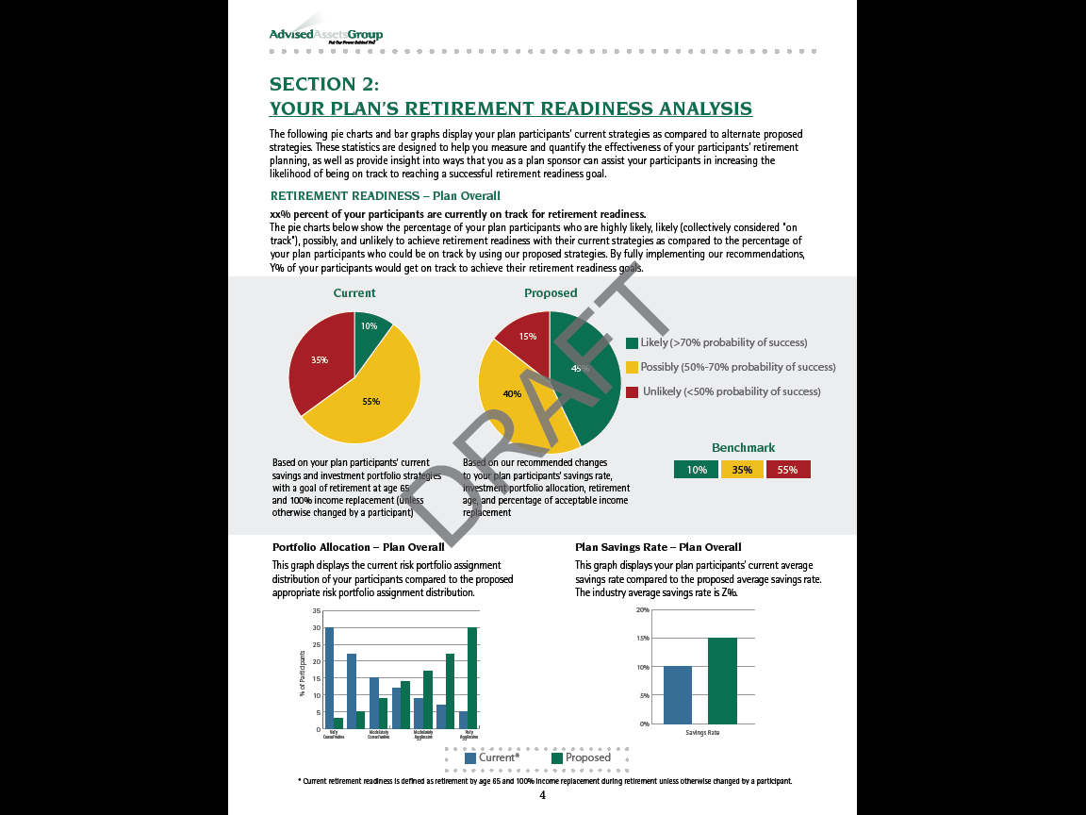
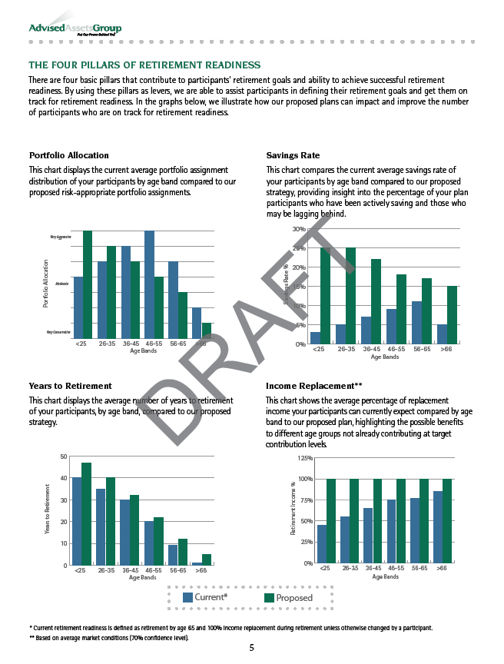
Plan Retirement Ready Report Card
Plan Specific Retirement Readiness Analysis
Four Pillars of Retirement Readiness
Notes:
The Retirement Readiness Report Card offers key insights to the plan sponsor of the financial health of the participants in their plan.
It’s a summary tool that provides the plan summary statistics to drive awareness and action.
This tool provides plan specific information about the Four Pillars of Retirement Readiness, which are:
Portfolio allocation
Savings rates
Years to retirement
And income replacement

Slide 15
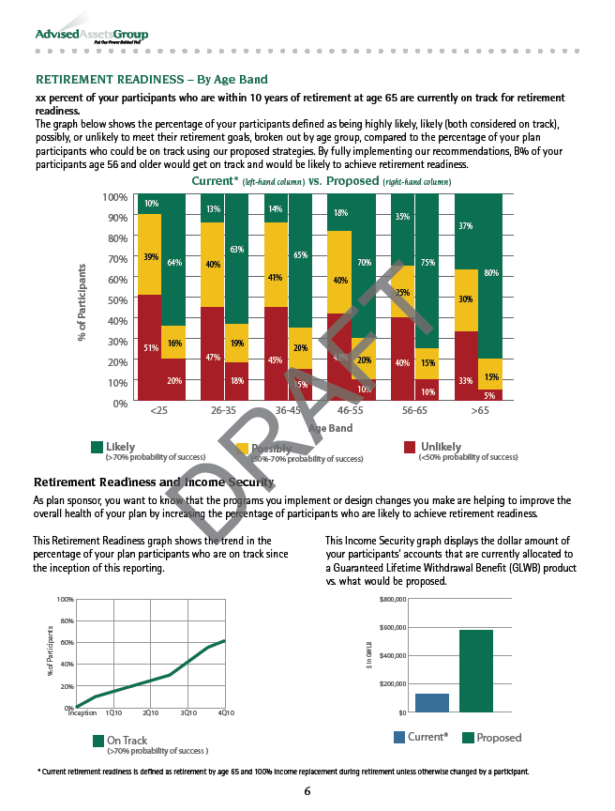
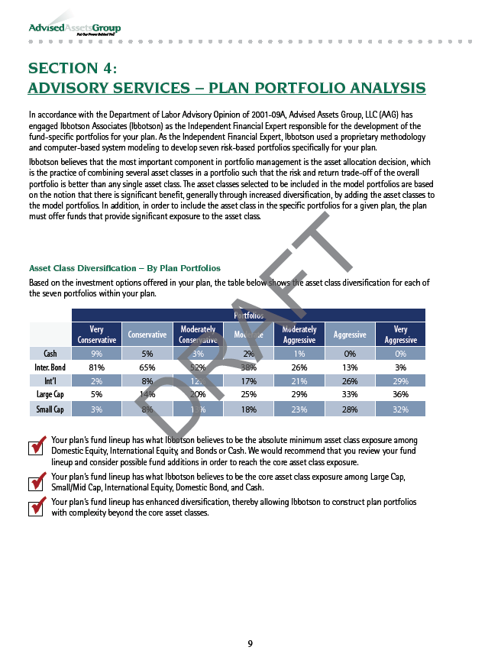
Plan Retirement Ready Report Card
Retirement Readiness Analysis
Advisory Services Plan Specific Portfolio Analysis
Notes:
This tool analyzes the retirement readiness of the plan participants and communicates to the plan sponsor in an easy to understand format using graphs and other charts to provide clear information participant behavior.
This tool provides information regarding advisory service plan specific portfolio analysis and fund utilization.

Slide 16
Plan Sponsor “Call-to-Action”
Empowers the Plan Sponsor with data around the Retirement Readiness of their plan participants
Insight into portfolio allocation and savings rates
Includes performance data
Provides investment risk profiles of participants
Communicates the potential benefits of Advisory Services’ recommendations as a way to improve overall Retirement Readiness
Intended to demonstrate opportunities for plan design changes and participant outreach opportunities
Notes:
The Retirement Readiness Report Card is also designed to be a “call-to-action” to the plan sponsor.
It is a powerful tool that empowers the plan sponsor with data around the retirement readiness of their plan participants.
The report offers insight into portfolio allocation and savings rates, including performance data and investment risk profiles of the participants.
It also communicates the potential impact of advisory services allocation as a way to affect overall retirement readiness through a holistic approach.
The Plan Retirement Readiness Report Card is intended to demonstrate opportunities for plan design changes and participant outreach opportunities.

Slide 17
Complementary Value Add Services
Provide plan sponsors collateral to support understanding of the value of advisory services in fulfilling their fiduciary responsibilities
Provide participants with a clear value statement, “call-to-action,” and pre- and post-letter statement stuffers
Additional 2nd Century AUA to AUM components
Offer Letter
Free Look Period
Education Center
Notes:
Once we help the plan sponsor identify ways to improve the retirement of their participants, we can also offer the plan sponsor complementary value add services.
We can provide the plan sponsor collateral to support the understanding of the value advisory services in fulfilling their fiduciary responsibilities.
Provide participants with a clear value statement, “call-to-action,” and pre- and post-letter statement stuffers
This may also lead into additional 2nd Century AUA to AUM components including:
The Offer Letter
The Free Look Period
And the Education Center

Slide 18
Offer Letter
What is it?
Communication to all non-managed account participants offering free personal financial review and consultation
To whom is it being offered?
Plan participants
What is the strategy, positioning and value?
Generates incremental revenue and potential for increased managed account participation
Opportunities for touch points
Increased close ratios
Updated participant profile
Saving rate discussions
Increased participant balances
Notes:
Let’s talk about the Offer Letter.
First,
What is it?
The Offer Letter is a communication sent to all non-managed account participants inviting them to enroll in Advisory Services via a personalized retirement readiness statement.
To whom is it being offered?
The Offer Letter is directed to plan participants with a clear value statement, or “call to action,”. Additionally, the Offer Letter provides plan sponsors collateral to support their understanding of the value of Advisory Services in fulfilling their fiduciary responsibility.
What are the strategy, positioning and value?
It details the ability to improve saving rates, improve asset allocation and increase the probability of meeting retirement goals. It provides opportunities for touch points resulting an increased close ratios, updated participant profile information, saving rate discussions and increased participant balances.

Slide 19
Free Look Period
What is it?
Allows participants to try Advisory Services “risk-free” for a defined period of time based upon their initial enrollment date
To whom is it being offered?
Plan participants not currently enrolled in Advisory Services
What are the strategy, positioning and value?
Increase awareness of Advisory Services and the likelihood that participants will sign up for managed accounts
Overcome behavioral obstacles to retirement planning by promoting a free trial period of managed account services
Notes:
The Free Look Period:
What is the Free Look Period?
The Free Look Period allows participants to try Advisory Services risk-free via a ‘try before you buy’ concept for a defined period of time based upon their initial enrollment date.
To whom is it being offered?
The Free Look Period is offered to plan participants not currently enrolled in Advisory Services. This can be a stand-alone offering or offered in tandem with the Offer Letter, statement stuffers, web page banner ads, pop-up messaging that describe advisory services to participants to drive participant action.
What are the strategy, positioning and value?
And what is the strategy, positioning and value? Our focus is to increase awareness of Advisory Services and the likelihood that participants will sign up for managed accounts. The Free Look period helps participants overcome common behavioral obstacles to the retirement planning process by promoting a free trial period of a managed account service. It provides participants a period of time to review their account recommendations without being charged for managed account services.

Slide 20
Education Center
What is it?
Experienced group of Series 65 licensed AAG investment advisor representatives available to consult with participants on strategies to prepare for retirement
To whom is it being offered?
Plan participants
What is the strategy, positioning and value?
Competitive differentiator
Offers participants access to Series 65 Licensed AAG Adviser Representatives
Increases AUM through out-bound call program
Answers participant questions and provides assistance with enrollment and participant account updates
Notes:
The Education Center:
What is the Education Center?
The Education Center offers participants the opportunity to talk one-on-one with AAG’s Registered Investment Advisor Representatives to assist them with their retirement goals and developing a strategy to reach those goals
To whom is it being offered? The Education Center is offered to plan participants.
What is the strategy, positioning and value?
The Education Center is a competitive differentiator and offers participants access to experienced, Series 65 licensed AAG advisor representatives. The participant can get answers to any questions, assistance with enrollment, and account updates. This team increases AUM through an outbound call program to increase deferral from managed account participants.

Slide 21
Product Stakeholders
Roles & Responsibilities
Field Sales Teams
Corporate 401(K)
National Accounts
Institutional Partners
Government
RFP Team
Pricing
Products
Pricing
Legal
Marketing
Operations
AAG Operations Team
Implementation
Administration
Products
Financial Control
Recoveries
Compliance
Plan Technical Support
Service Teams
AAG Service Delivery Associates
Plan Management
Account Managers
Client and Plan Services
Participant Call Center
Notes:
So who are the product stakeholders and who will these initiatives impact?
As you can see, there is a large operational impact of these initiatives. They touch everybody from the field sales teams, the operational components of the service team, and everyone in between - including Products, Pricing, Marketing and Legal. Individual team meetings will address operational and SOP changes.

Slide 22
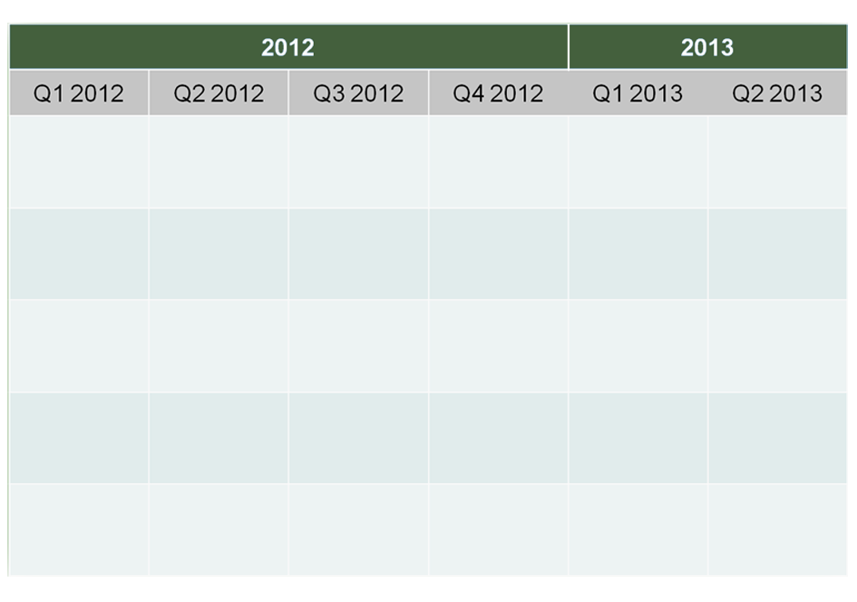
Event Timeline
April 1st – Free Look and Offer Letter Available
May 2012 – Plan Retirement Readiness Beta testing
July 2012 – Retirement Readiness Report Card Beta testing on select plans
October 2012 – Retirement Readiness Report Card available for all Advisory Services plans.
Early 2013– Launch Retirement Readiness Report Card for non-Advisory Services plans
Notes:
So how does this impact you and your team?
Let’s walkthrough the timeline. On April 1st, we will bring to market the Free Look Period and the Offer Letter. We will make it available for current in service plans and for new plans in the sales process.
In May of this year, the Plan Retirement Readiness Report Card will be available for beta testing. In the beta test, we will select plans from each line of business and offer a very controlled preview of the Report Card. This is to solicit feedback from the field force and plan sponsors on how we can improve the Report Card product.
In July of 2012, the Retirement Readiness Report Card will be available to all Advisory Services plans, but will only be available by request. The service representative or the client service manager will have to initiate this report to deliver to plan sponsors.

Slide 23
Learning Activity #2
Match the terms to their descriptions.
1
Retirement Readiness Report Card
1
Tool to measure and analyze participant retirement-readiness
2
Offer Letter
2
Communication to all non-managed account participants offering free personal financial review and consultation
3
Free Look Period
3
Allows participants to try Advisory Services risk-free for a defined period of time based on initial enrollment date
Education Center
4
An experienced group of Series 65 license AAG investment advisor representatives available to consult on retirement strategies
4
5
Participant Retention Program
5
Identifies root causes of participant terminations while seeking to retain the participants in Advisory Services
Terms and their Answers match by number.
Notes:
In this activity, match the terms to their description.

Slide 24
The Re-Engineered Managed Account
Opt-Out Enrollment Process

Slide 25
The Re-Engineered Managed Account Opt-Out Enrollment Process
What is it?
Alternative choice during plan conversion to Great-West platform
Makes opt-out process easier to implement
Reduces time plan sponsor is engaged in implementation process
Provides more friendly experience for participant
To whom is it being offered?
Plan sponsors and participants
What are the strategy, positioning, benefits?
Makes opt-out process more efficient for plan sponsor
Attractive option during sales process
Develop more opt-out business; increasing participation in Advisory Services
Notes:
What is it?
The Re-Engineered Managed Account Opt-Out Enrollment Process is an alternative choice for plan sponsors to use during a plan conversion to the Great-West platform.
Currently during a conversion to the Great-West platform, if a plan sponsor decides to offer managed accounts as a participant option. There are two methods available to offer managed accounts.
First is the opt-in plan in which the plan allows participants to voluntary enroll in managed accounts at any point.
Second is an opt-out option which will enroll all eligible participants into managed accounts during the implementation process. Participants can choose to opt out of the managed account service.
This 2nd Century initiative :
makes the Opt-out process easier to implement
reduces the time necessary for plan sponsors to engage in the implementation process, and
provides a friendlier experience for the participant
To whom is it being offered?
Plan sponsors are offered this process during a plan conversion onto the Great-West platform. This process improves the implementation experience for the plan participant.
What are the strategy, positioning and benefits?
By making the Opt-out process more efficient for the plan sponsor, it becomes an attractive option during the sales process. The retention rate of participants that are enrolled in managed accounts is much greater than the retention rate of opt-in plans. This initiative is designed to develop more opt-out business thereby increasing participation in Advisory Services.

Slide 26
The Need for Change
Feedback from Great-West field regarding Current Process
Too confusing
Implementation too long
Need for better communication
Market necessity to change/simplify
Improve the participant experience
More directly integrated with the overall plan conversion process
Shortened implementation timeline
Preview of advice
Notes:
If we already offer an opt-out solution, why was there a need for change?
The feedback we received concerning the current process is that the process is too confusing. Second, feedback indicated the implementation process is too long and taxing on the plan sponsor. And third, better communication was needed.
The market has driven the simplification of the opt-out process, including the need to improve the participant experience.
The new process is directly integrated with the overall plan conversion process to shorten the implementation timeline and provide a preview of advice being offered through the managed accounts process.

Slide 27
Improvements to the Opt-out Process
Evaluated the current opt-out practice
Compared to strategy with Maxim Lifetime Allocation Series®/ Target-Date Funds
Assessed optimal positioning of our services to plan sponsors
Appeals to and engages plan participants
Expanding regulatory environment
Investment advice will continue to grow in importance
Shift in industry focus
Managed accounts well positioned to capitalize on shift to outcomes-based focus
Service attributes of managed accounts are highly valued
Notes:
Following up on the need for change, we evaluated the current Opt-out process and compared it with Maxim Life Time Allocation Series®, or MLAAS, and Target-Date Fund implementation. Our goal was to assess whether the current process optimally positions our services for plan sponsors, and appeals to or engages the plan participants.
Additionally, in the expanding regulatory environment, investment advice will continue to grow in importance. Continued expanding regulatory environment will support the need and encourage (if not mandate) the existence and availability of such services.
The Managed Accounts Service is highly valued by participants and plan sponsors as the industry shifts to an outcome-based Retirement Income focus. The service attributes of manage accounts are highly valued by participants and plan sponsors.

Slide 28
Solution Proposition
Develop a streamlined and integrated process
Less confusing for plan sponsors and participants
Implementation in tandem with plan conversion
Enhanced communication
Preview of advice to participants
Improved participant experience at a lower price
Encourage and revive plan sponsor and advisor interest in mapping to managed accounts
Notes:
Given these needs for a change, what did we propose?
We proposed a solution to develop a streamlined and integrated process:
This process is designed to be less confusing for plan sponsors and participants
The implementation into the managed account solution will be in tandem with the plan conversion
There will be enhanced communication to plan participants which will include a preview of advise to participants
it will provide an improved participant experience at a lower price and encourage and revive plan sponsors and advisor interest in mapping to manage the accounts.

Slide 29
Pending SEC Approval
Currently do not have SEC approval
Summer 2010 - Engaged outside counsel to confer with SEC
June 2011 - Received a favorable response , allowing us to continue with formal request
November 2011 - Filed a formal request , or “No-Action Letter”, with the SEC
Currently pending review
Request now with the SEC
If approved by the SEC, will allow us to promote our Opt-out Process as compliant with SEC requirements
Notes:
It is important to note that we currently do not have SEC approval on the Re-Engineered Managed Account Opt-out Enrollment Process.
In the summer of 2010, we engaged outside council to confer with the SEC and received a favorable response in June of 2011. This response allowed us to continue with a formal request, and in November of 2011 we filed a formal request, or a No-Action letter with the SEC. Currently it is pending review.
This is a groundbreaking request with the SEC, and if approved, will allow us to promote our Opt-out processes compliant with SEC regulations.

Slide 30
Learning Activity # 3
Identify the Benefits of the Re-Engineered Managed Accounts Opt-Out Enrollment Process by dragging the phrases on the left to the Benefits box.
Alternative choice during a plan conversion
Correct
Provides a participant friendly experience
Correct
Produces less communication
Re-Engineered Managed Accounts Opt-out Enrollment Process
Benefits
Too confusing
Reduces plan sponsor’ engagement time in implementation process
Correct
Implementation time lengthened
Opt-out process easier to implement
Correct
Notes:
Identify the Benefits of the Re-Engineered Managed Accounts Opt-Out Enrollment Process by dragging the phrases on the left to the Benefits box on the right.

Slide 31
Summary

Slide 32
Next Steps and Resources
Next Steps
Look for more information:
Team meetings
Detailed sales tips
Procedural changes
Resources
Notes:
Narration
Next Steps
Look for more information in:
Team meetings
Detailed sales tips
Procedural changes
Resources

Slide 33
Summary
Now that you have completed this course, you should be able to:
Define Advisory Services
Explain the Advisory Services Retirement Readiness Products and Services Enhancements
Describe the strategy, positioning, and value of the Advisory Services Retirement Readiness Products and Services Enhancements components
Explain the roles and responsibilities associated with this initiative
Define the Re-Engineered Managed Account Opt-Out Enrollment Process
Describe the strategy, positioning, and value of the Re-Engineered Managed Account Opt-Out Enrollment Process
Notes:
Now that you have completed this course, you should be able to demonstrate the following objectives:
(Don’t need to read the objectives. Participant can read on their own)

Slide 34
Final Assessment
This course includes a knowledge assessment.
You must score 100% to receive a “Complete” status on your TMS training transcript.
You may take the assessment as many times as necessary to achieve 100%.
The knowledge assessment has 10 questions.
Click Next to begin the assessment.
Notes:
This course includes a knowledge assessment.
You must score 100% to receive a “Complete” status on your TMS training transcript.
You may take the assessment as many times as necessary to achieve 100%.
The knowledge assessment has 10 questions.
Click Next to begin the assessment.

Slide 35
Assessments 1 and 2
Advisory Services provides participants with the opportunity to receive investment assistance from the accumulation of savings stage through the spend up stage.
True
False
Advisory Services lets the participant choose the level of involvement they want in making choices in their retirement plan.
True
False
Answers are in shaded boxes.

Slide 36
Assessments 3 and 4
(Multiple Choice) The components of the Advisory Services Retirement Readiness Products and Services Enhancements are: choose all that apply) Answers (A, B, C, F, G)
A
Retirement Readiness Report card
E
Participant Website
B
Offer Letter
F
Education Center
C
Free Look Period
G
Reengineered Managed Account Opt-Out Enrollment Process
D
Participant Statements
The new components of Advisory Services Retirement Readiness Products and Services Enhancements communicate the potential impact of Advisory Services as a tool to use in affecting overall retirement readiness.
True
False
Answers are in shaded boxes.

Slide 37
Assessments 5 and 6
Match the Advisory Services component to their descriptions.
A
Retirement Readiness Report Card
A
Generates consultative discussions.
B
Offer Letter
B
Provides opportunities for participant touch points.
C
Free Look Period
C
Increases the likelihood that participants will sign up for Managed Accounts
D
Education Center
D
Offer participants access to Series 65 licensed AAG Advisor Representatives
Correct component and completion phrase match by letter.
The Advisory Services initiative was designed to increase and retain plan and participant enrollments.
True
False
Answer to true/false is in shaded boxes.

Slide 38
Assessments 7 and 8
Plan participants can choose “opt-in” managed accounts as the method to auto-enroll all employees into managed accounts as part of the plan’s implementation.
True
False
The Re-Engineered Managed Account Opt-Out Enrollment Process is directly integrated with the overall plan conversion process to shorten the implementation timeline and provide a preview of advice being offered through the managed accounts process.
True
False
Answers are in shaded boxes.
Notes:
The new process is directly integrated with the overall plan conversion process to shorten the implementation timeline and provide a preview of advice being offered through the managed accounts process.

Slide 39
Assessments 9 and 10
Select the two benefits of the Re-Engineered Managed Account Opt-Out Enrollment Process:
A
Makes the opt-out process more attractive during the sales process with its increased efficiency for the plan sponsor.
B
Designed to decrease the retention rate of participants enrolled in managed accounts.
C
Designed to develop more opt-out business to increase participation in Advisory Services.
D
Increases the time the plan sponsor is involved in the implementation process.
The Re-Engineered Managed Account Opt-Out Enrollment Process process is currently pending SEC approval.
True
False
Answers are in shaded boxes.

